Slide 1
Treatment breakdown for oesophagus cancers
This work has been produced as part of the Cancer Research UK - Public Health England Partnership. Contributors are listed at the end.

Slide 2
Methods 1)
These slides present the numbers and percentages of tumours diagnosed in England in 2013 - 2015 recorded as receiving radiotherapy, chemotherapy or tumour resection. The results are presented by year, stage at diagnosis, age, sex, deprivation, ethnicity, and comorbidities. The stage distribution is presented, followed by the treatment breakdown (independently and in combinations) for each variable.
This work uses data collected by the NHS, as part of the care and support of cancer patients.
Detail on methodology is described in the SOP and workbook (here) and summarised below:
These proportions are unadjusted, so patterns may be caused by differences in stage, deprivation, age, sex, ethnicity, comorbidities or other factors, such as patient choice.
Datasets used to capture treatment information include cancer registration data, the Systemic Anti-Cancer Therapy dataset (SACT), RadioTherapy DataSet (RTDS), and inpatient Hospital Episode Statistics (HES).
A tumour resection is an attempt to surgically remove the whole of the primary tumour.
Radiotherapy includes both curative and palliative teletherapy procedures, and excludes brachytherapy and contact radiotherapy.
Chemotherapy includes both curative and palliative chemotherapy, and excludes hormonal therapy, and other supportive drugs such as zoledronic acid, pamidronate, and denosumab.

Slide 3
Methods 2)
On the graphs which display combinations of treatments received, one of the categories is ‘Other care’. ‘Other care’ represents the group of patients who had no record of chemotherapy, tumour resection, or radiotherapy in the time frame assessed. This may include patients who received other treatments (such as hormonal therapy or management of symptoms), treatment outside of the time frame assessed, treatment in a private setting, or there may be data missing from the datasets used.
The patient's Charlson comorbidity score was derived from Hospital Episodes Statistics (HES) and Cancer Registry data combined, and looks from 27 months to 3 months before the patient's cancer diagnosis.
The patient’s age group was based on the age of the patient when they were diagnosed with the tumour.
The patient’s income deprivation quintile was allocated by linking the patient’s postcode to their 2011 ONS census lower super output area (LSOA). This was then linked to the Ministry of Housing, Communities & Local Government 2015 income deprivation quintile for that LSOA.
Treatments occurring in the period from 1 month before diagnosis to either 6, 9, 12, 15 or 18 months after diagnosis are displayed. The time period within which most patients' first course of treatment occurred varies by cancer site and treatment type. Therefore, an appropriate time period for each cancer site has been chosen using a data-driven approach in consultation with clinicians (see SOP for more information).

Slide 4
Summary of key results
Stage: The highest proportion of tumours treated with resection is in stage 1, highest radiotherapy proportion in stage 2, and the highest chemotherapy proportion in stage 3.
Age: There is a stark reduction in chemotherapy by age. Unfortunately the toxicity of chemotherapy means it is reserved for younger patients or when used in a palliative setting for those who are fit. There is little variation in radiotherapy by age. Radiotherapy tends to be less toxic and can be given at varying doses meaning that even a single fraction can produce a specific response even in a palliative setting.
Sex: There seems to be a stark difference in treatments by sex, where a higher proportion of males are receiving chemotherapy and tumour resection compared to females, and a higher proportion of females are receiving radiotherapy. It’s not clear why this is occurring. Despite the fact oesophageal cancers are more common in men, the variation does not appear to be explained by this.
Deprivation: There is a reduction in the proportion of tumours treated with chemotherapy, radiotherapy and tumour resection by deprivation quintile. Deprivation can be related to comorbidities therefore the patterns may be explained by comorbidity, which is not adjusted for.
Ethnicity: There is a higher proportion of patients receiving radiotherapy among non-White individuals (40%). The confidence intervals are wide however the proportion is drastically different to the White proportion (30%). Squamous cell carcinomas tend to be more common in certain non-White ethnic groups and this type of cancer responds well to radiotherapy, contributing to the differences observed.

Slide 5
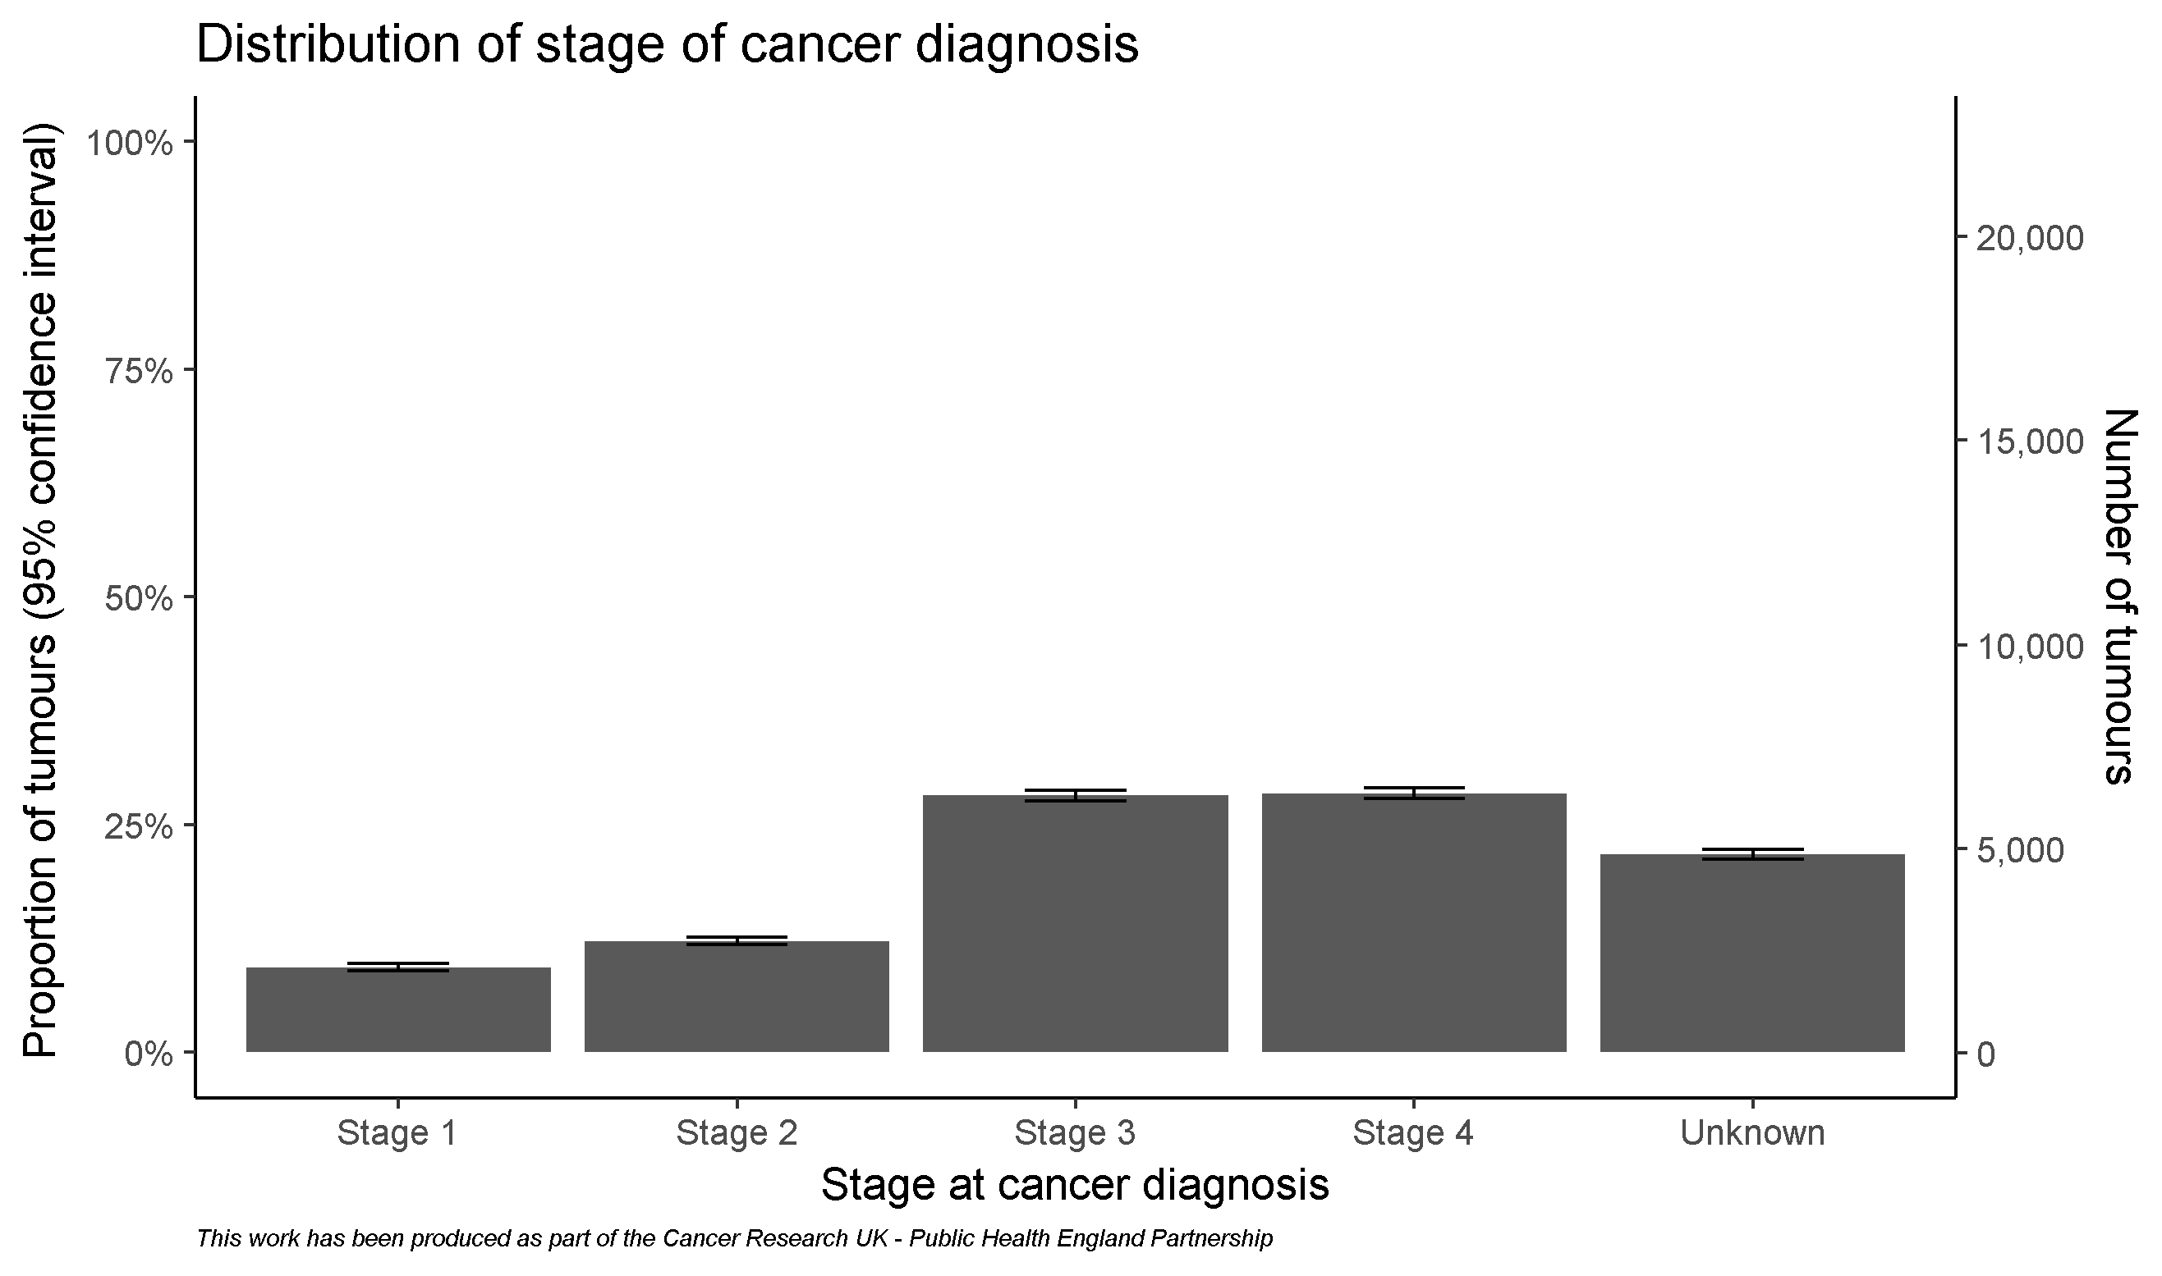
Cohort for oesophagus cancers

Slide 6
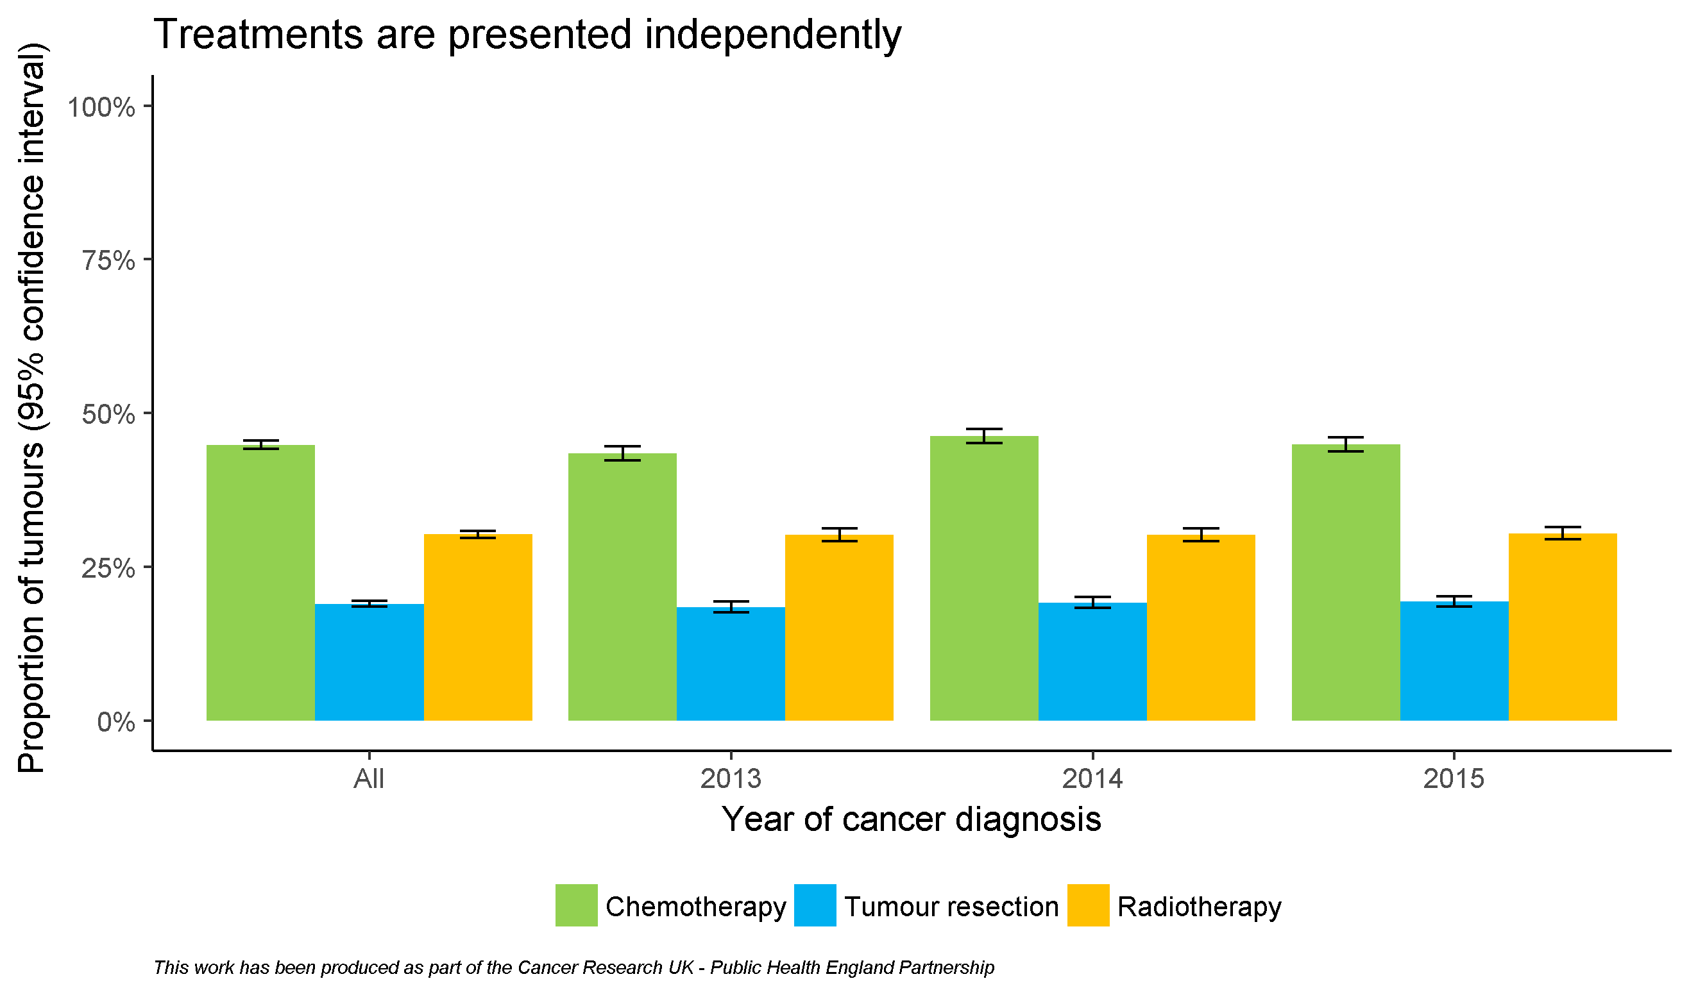
By diagnosis year

Slide 7
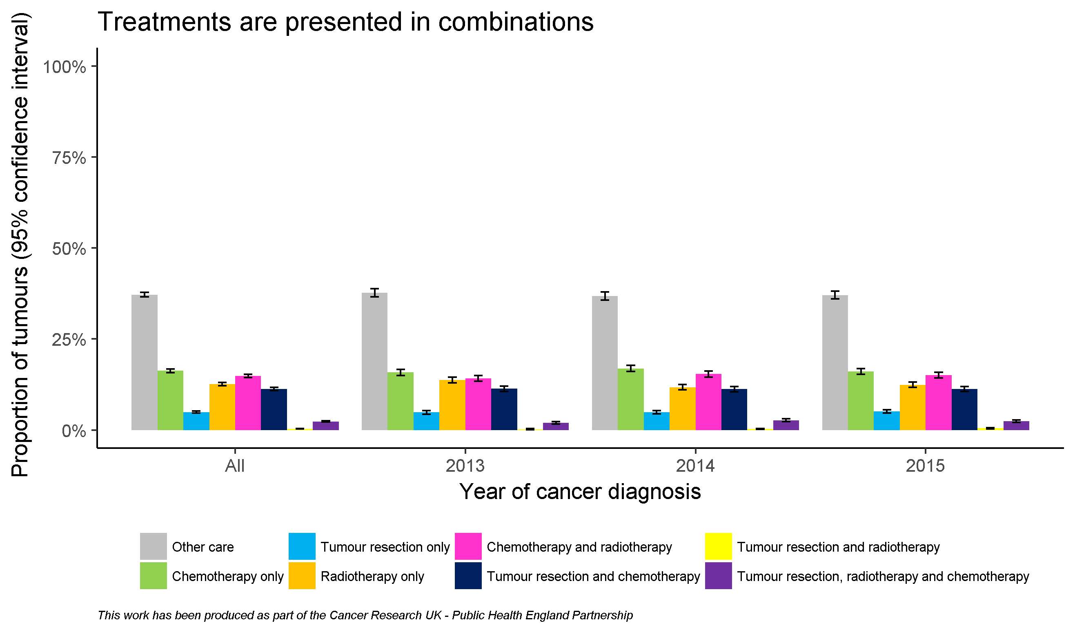
By diagnosis year

Slide 8
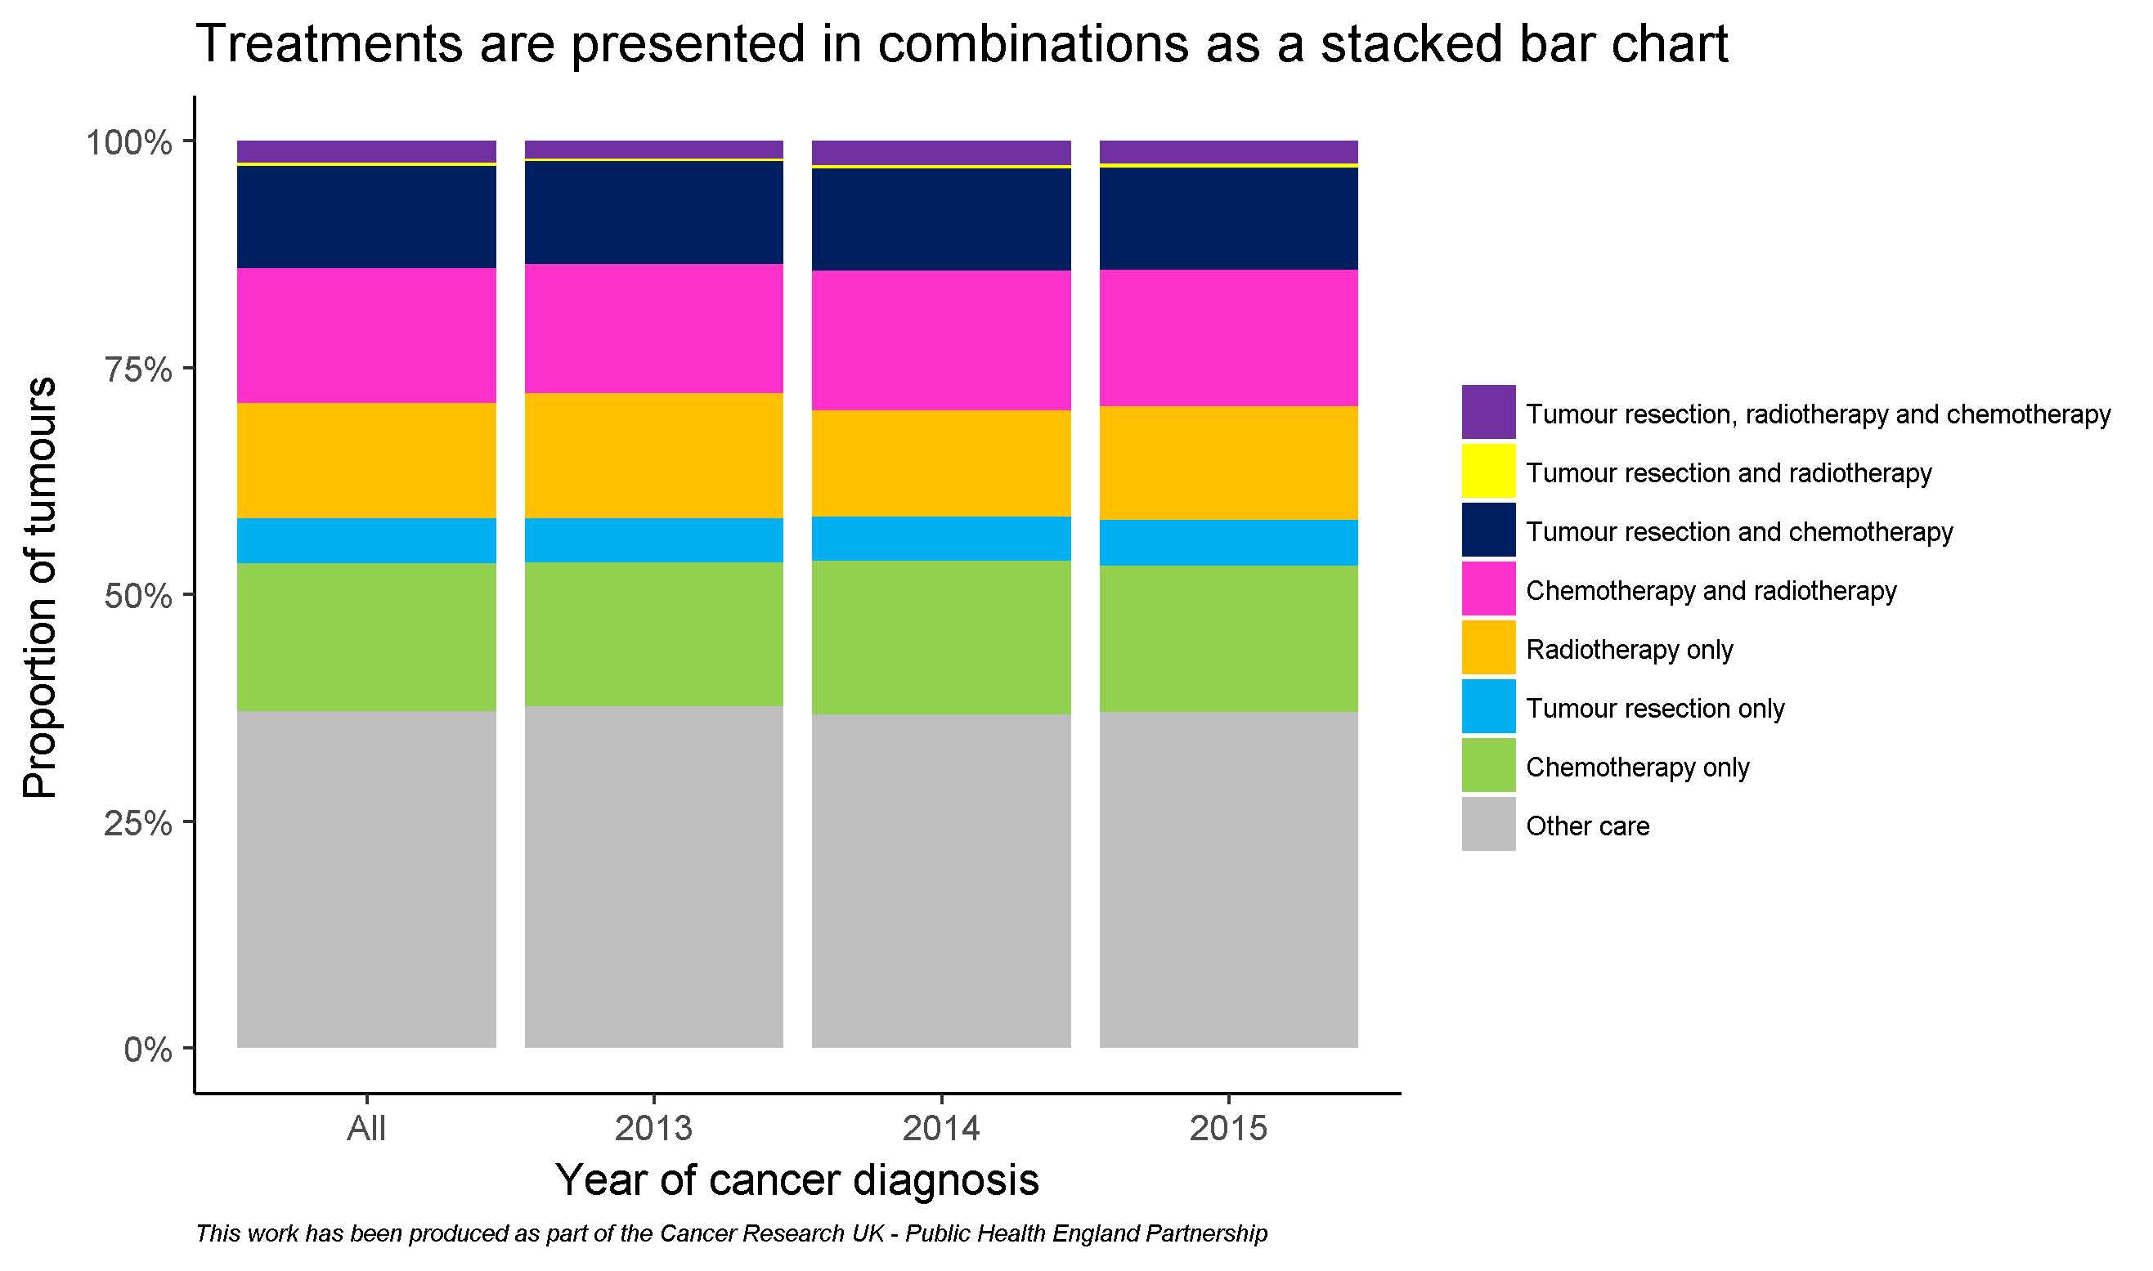
By diagnosis year

Slide 9
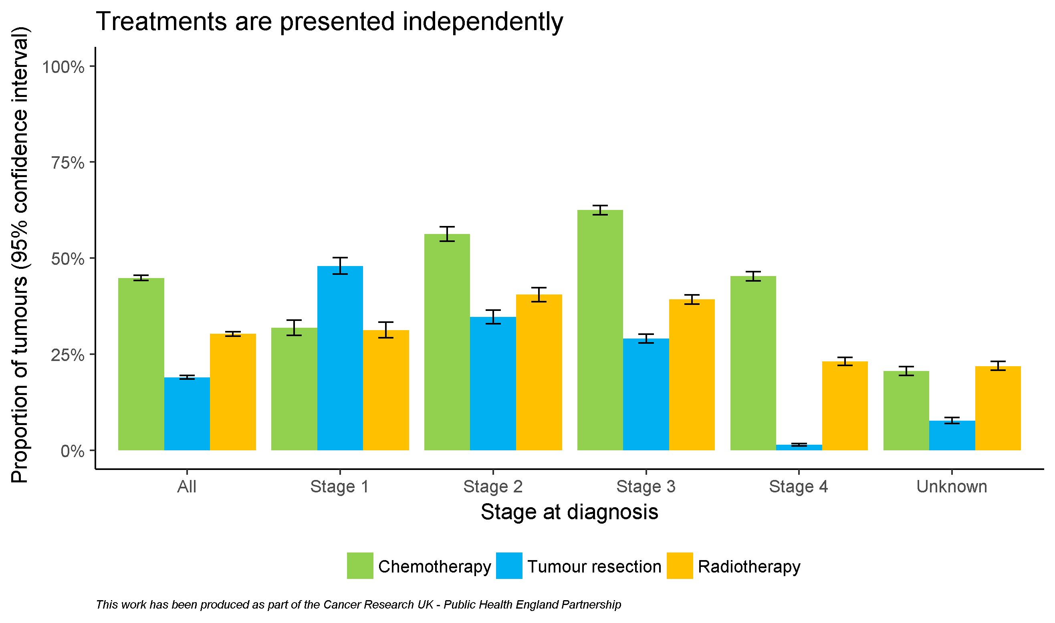
By stage

Slide 10
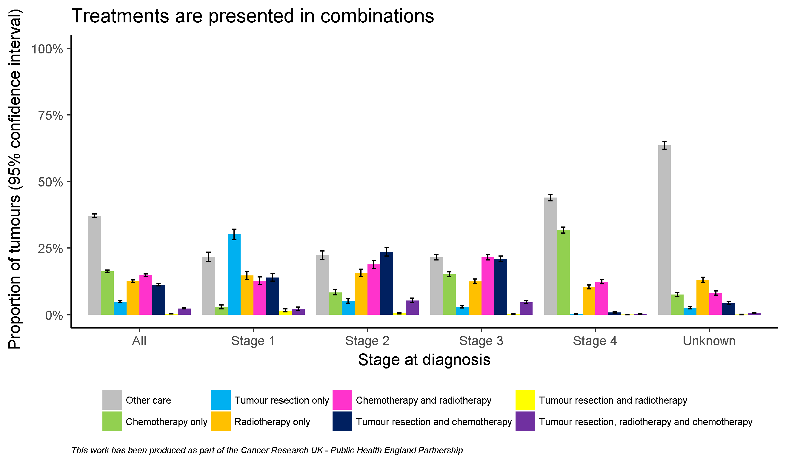
By stage

Slide 11
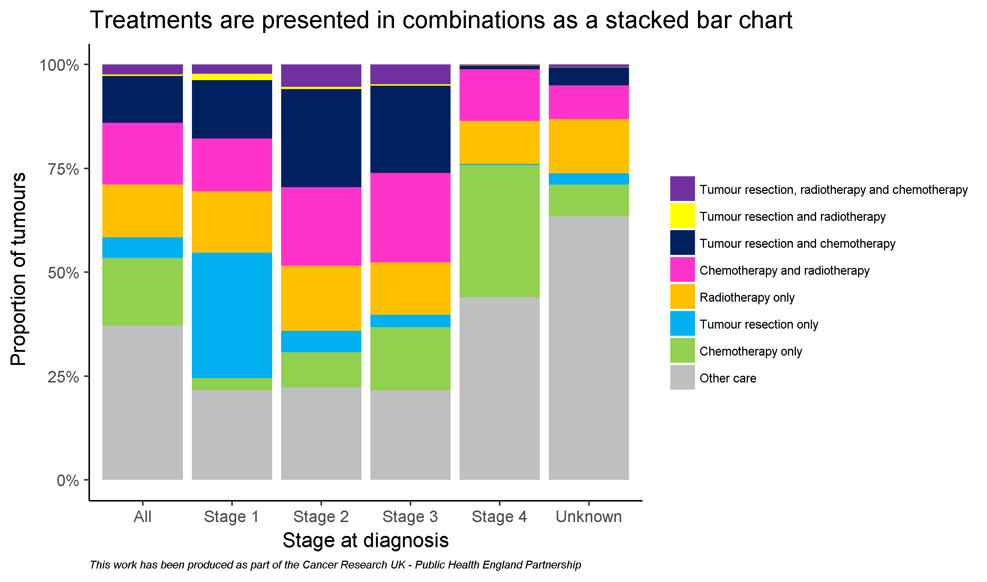
By stage

Slide 12
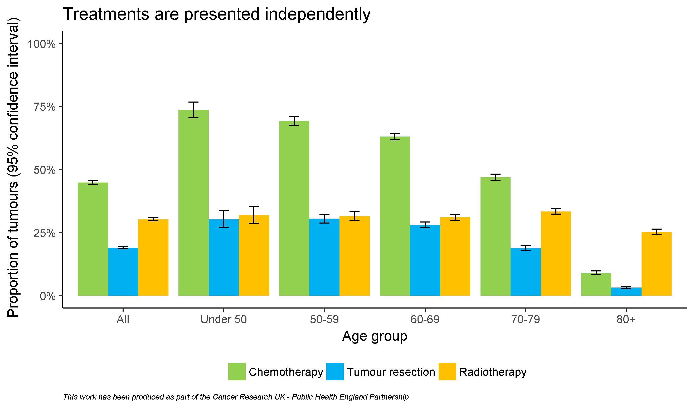
By age

Slide 13
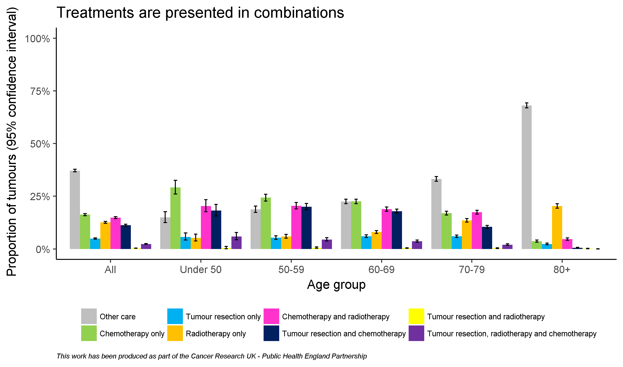
By age

Slide 14
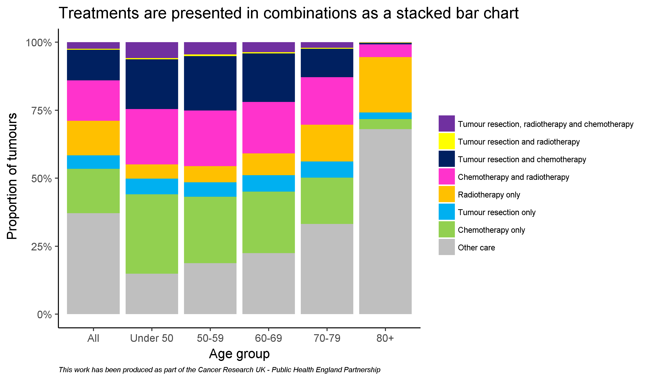
By age

Slide 15
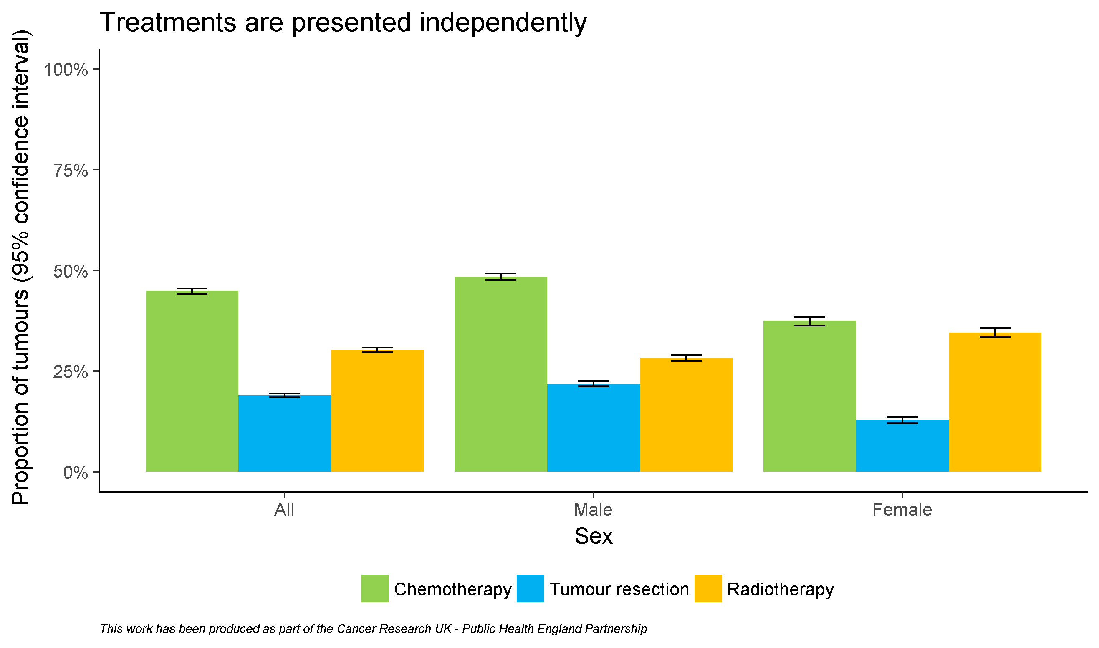
By sex

Slide 16
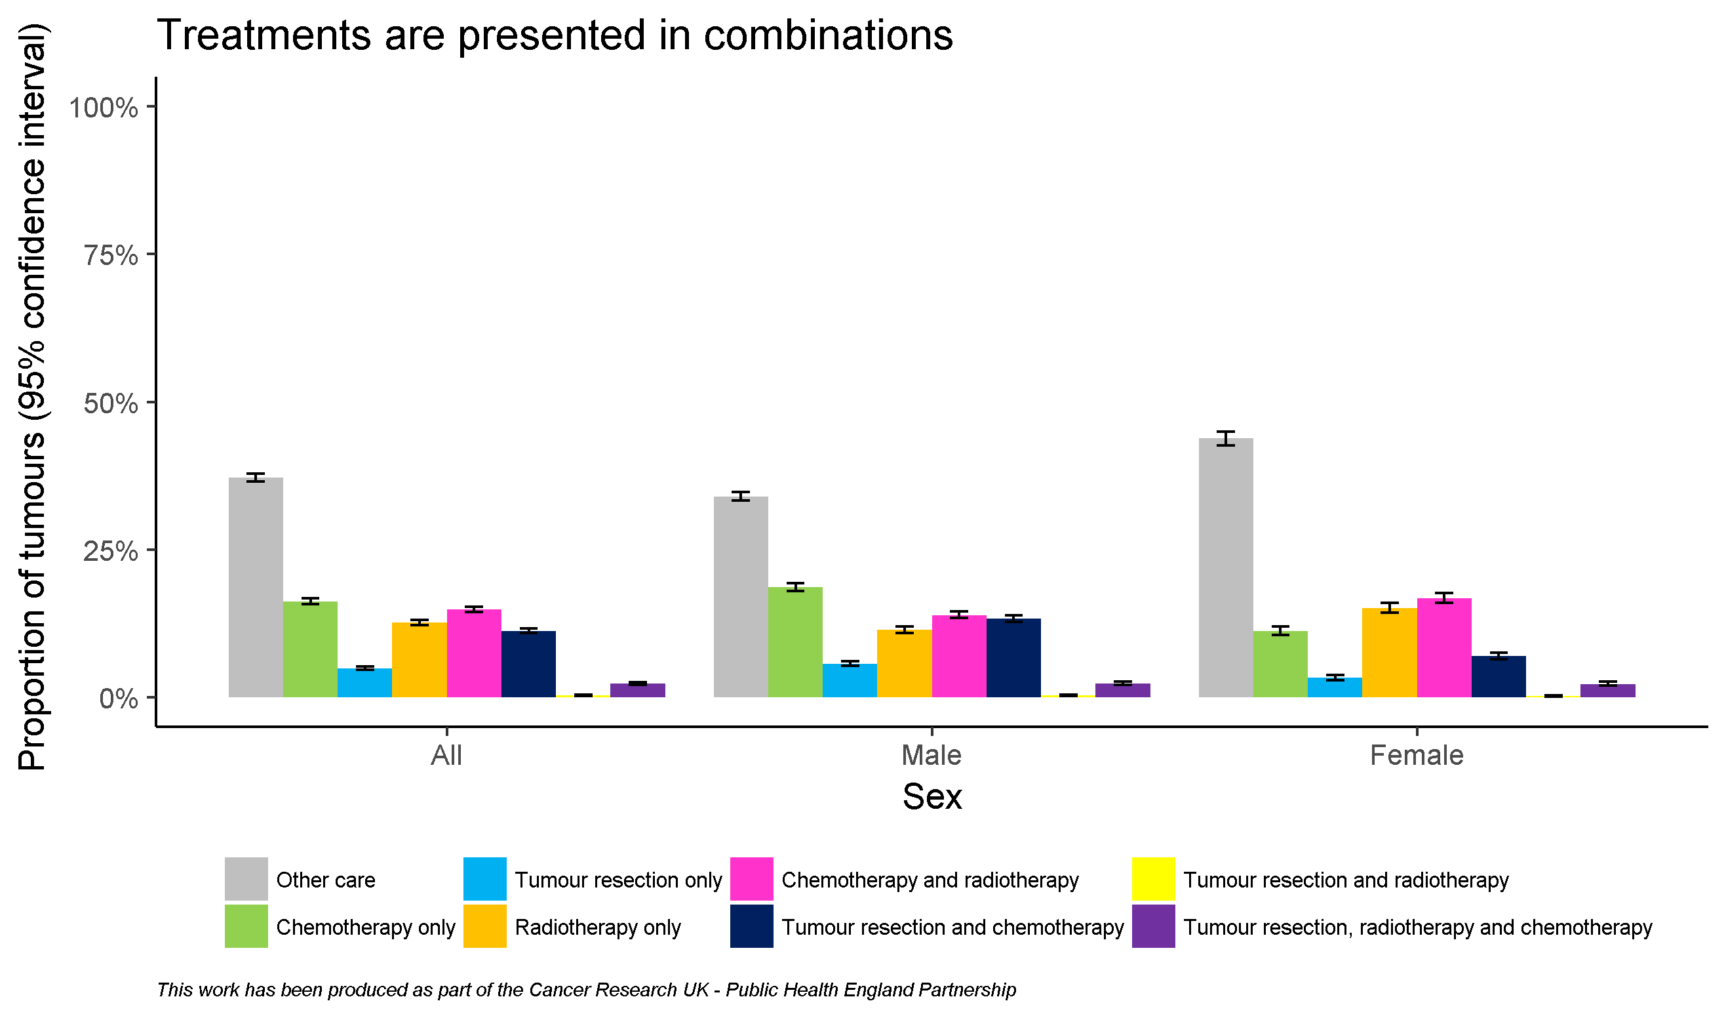
By sex

Slide 17
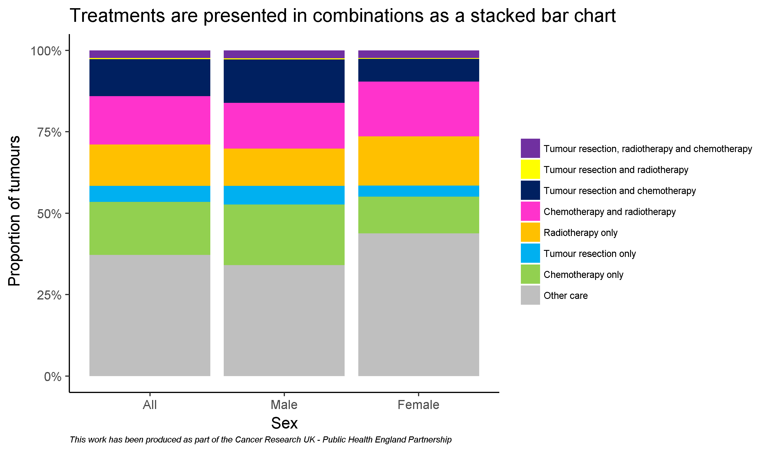
By sex

Slide 18
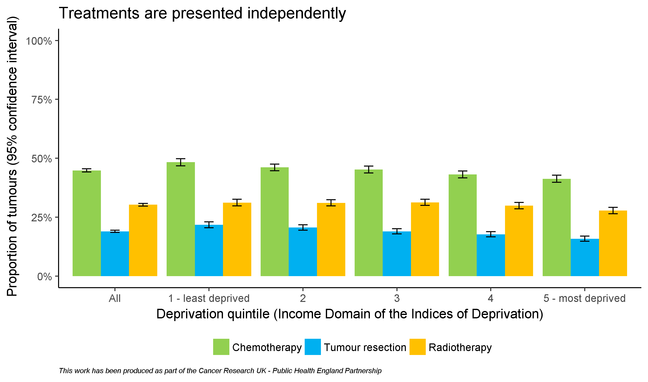
By deprivation quintile

Slide 19
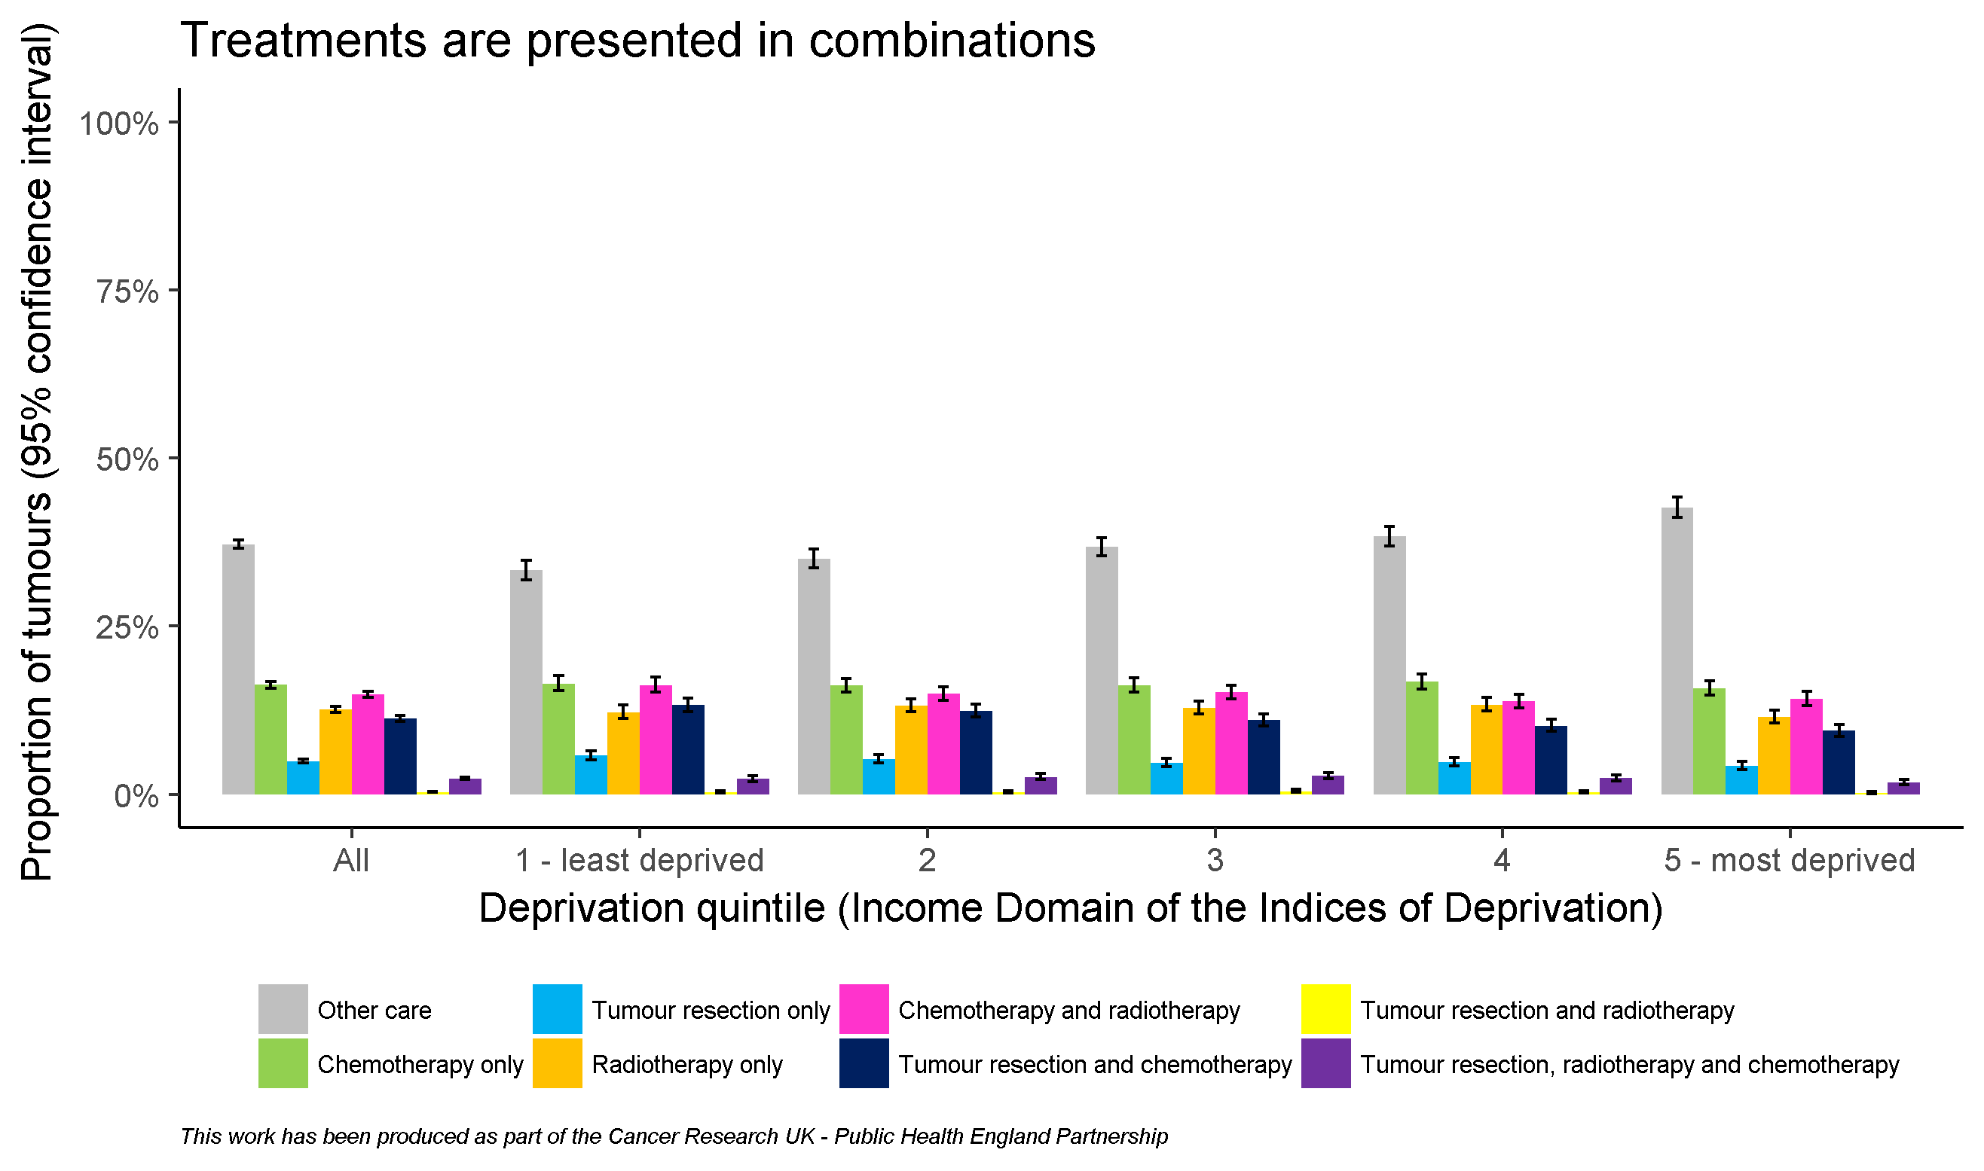
By deprivation quintile

Slide 20
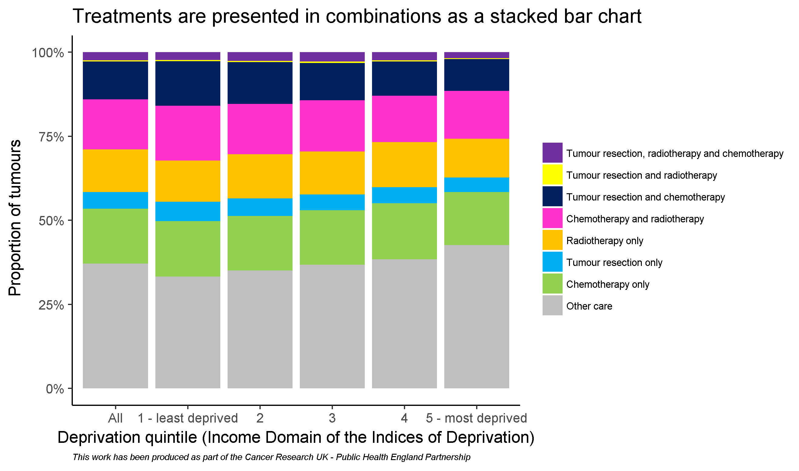
By deprivation quintile

Slide 21
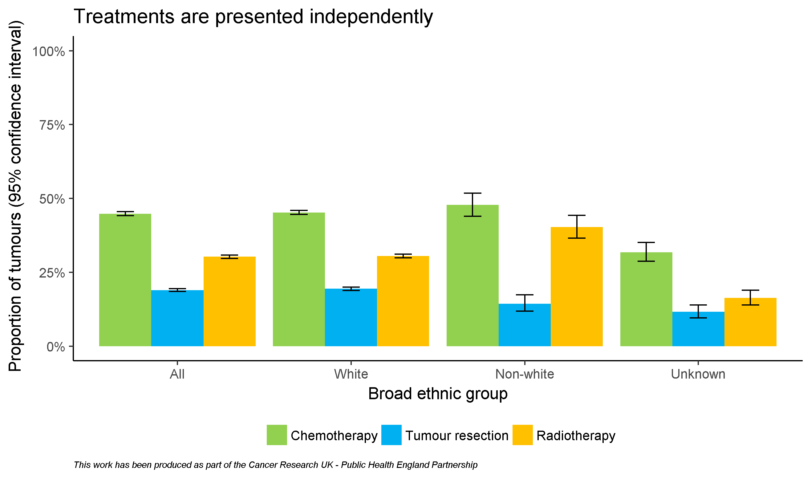
By broad ethnic group

Slide 22
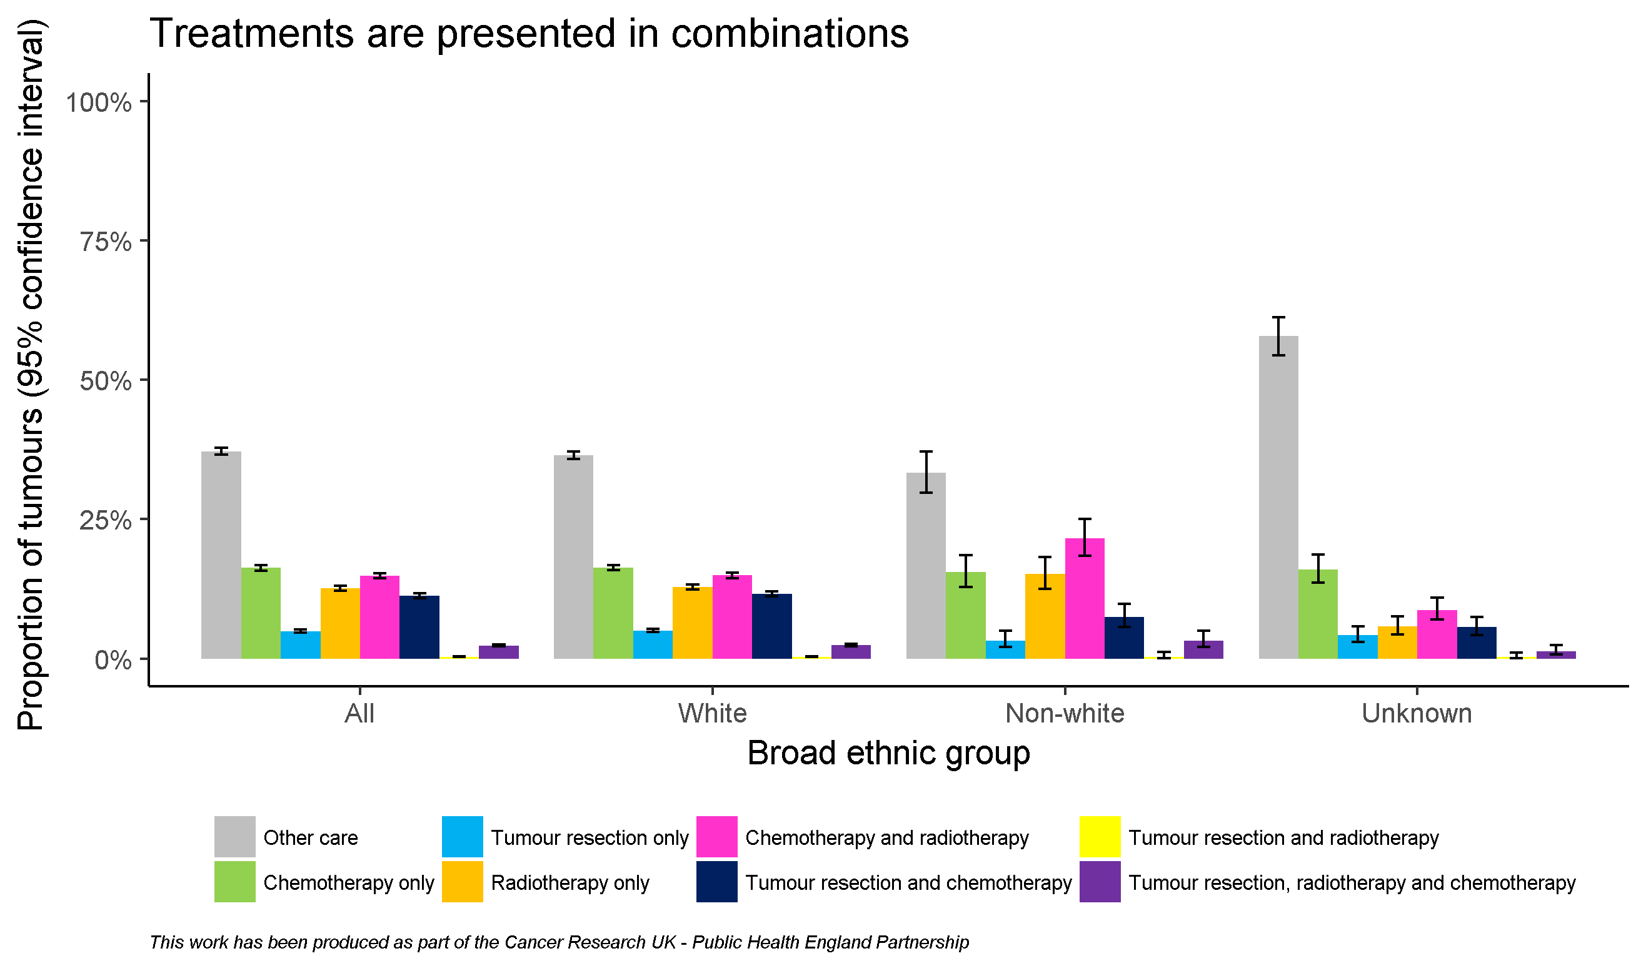
By broad ethnic group

Slide 23
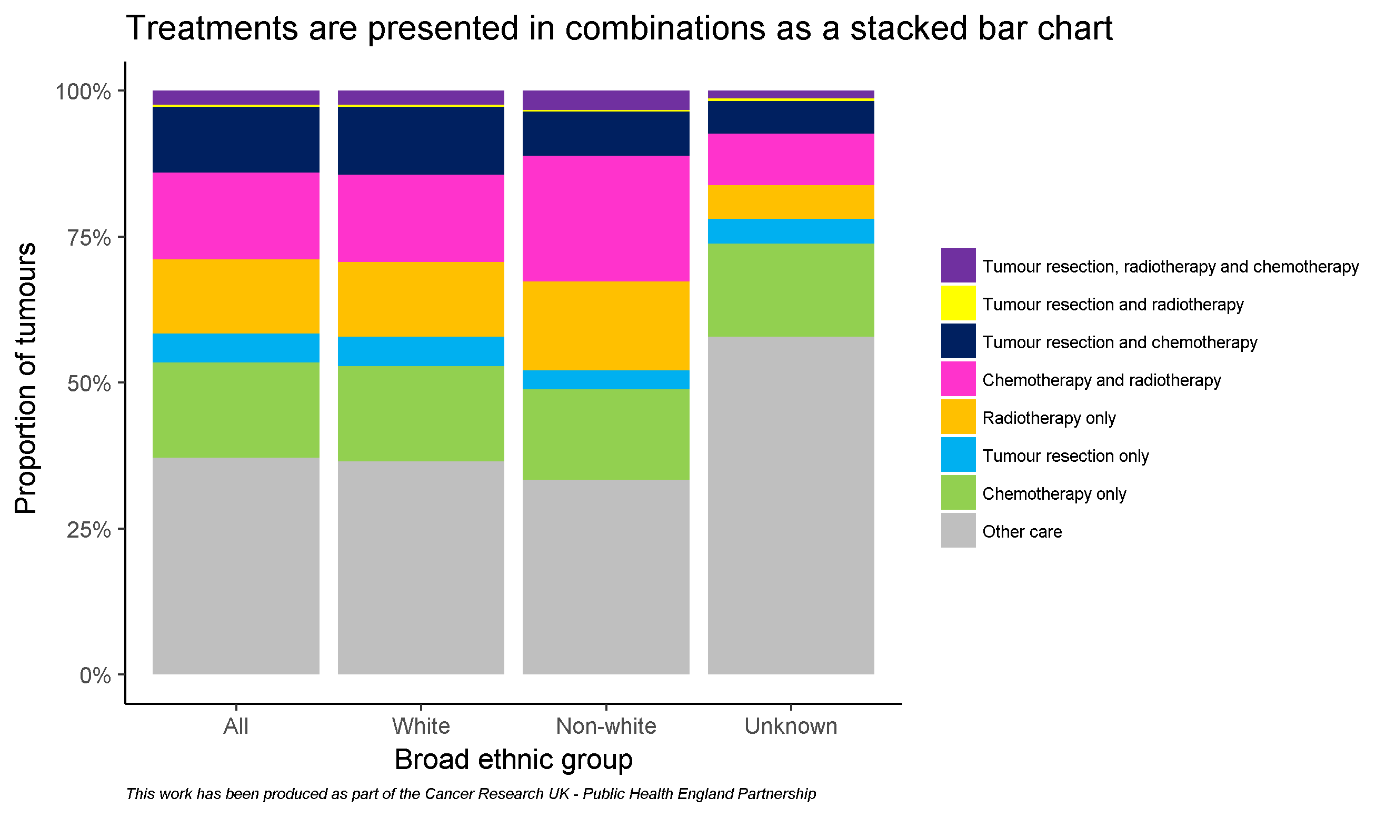
By broad ethnic group

Slide 24
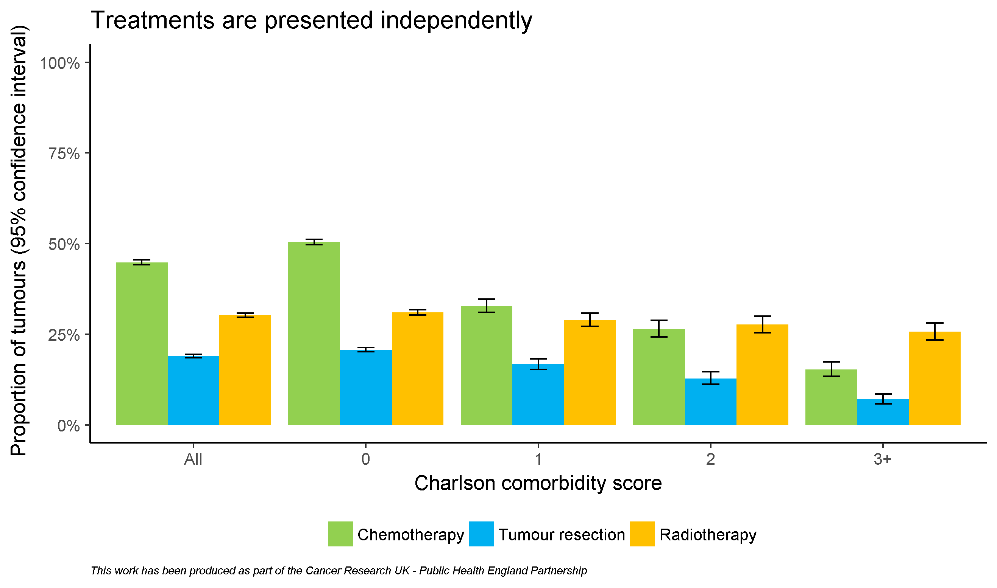
By comorbidity score

Slide 25
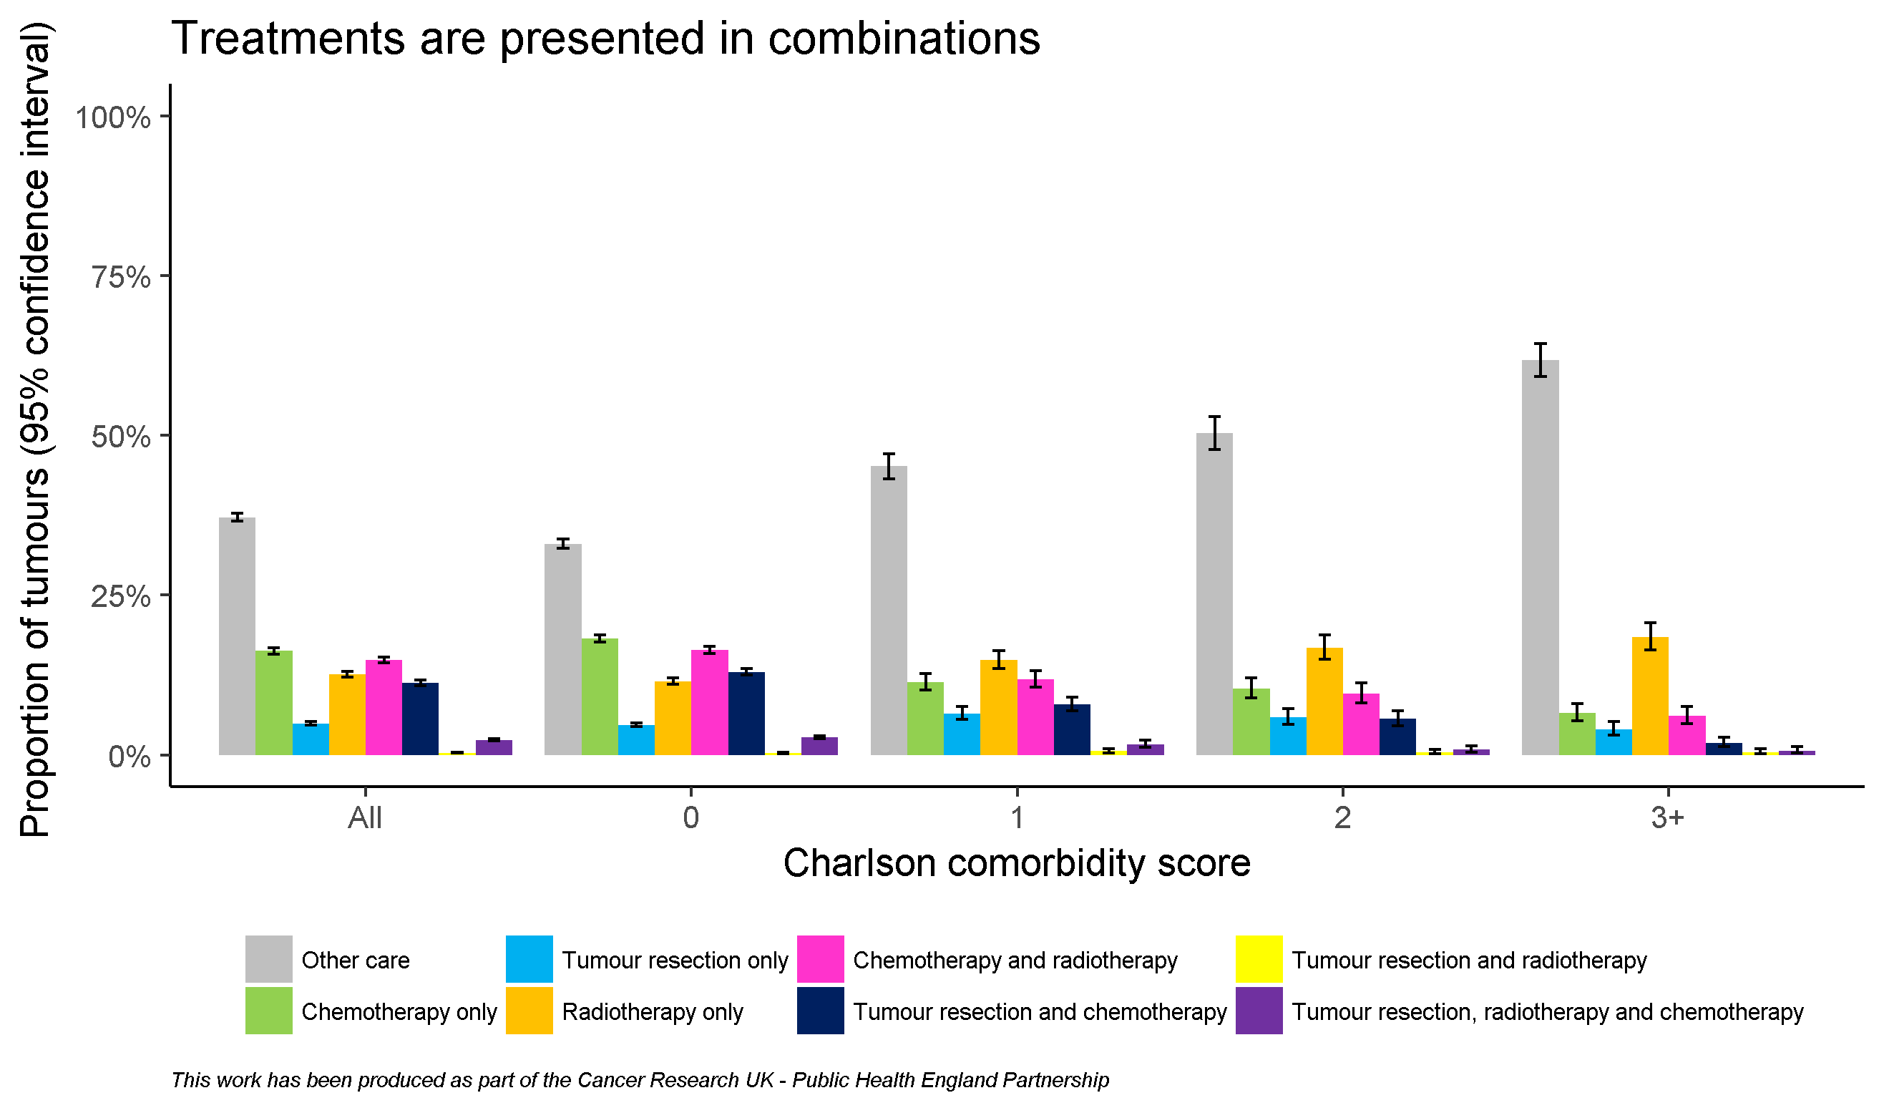
By comorbidity score

Slide 26
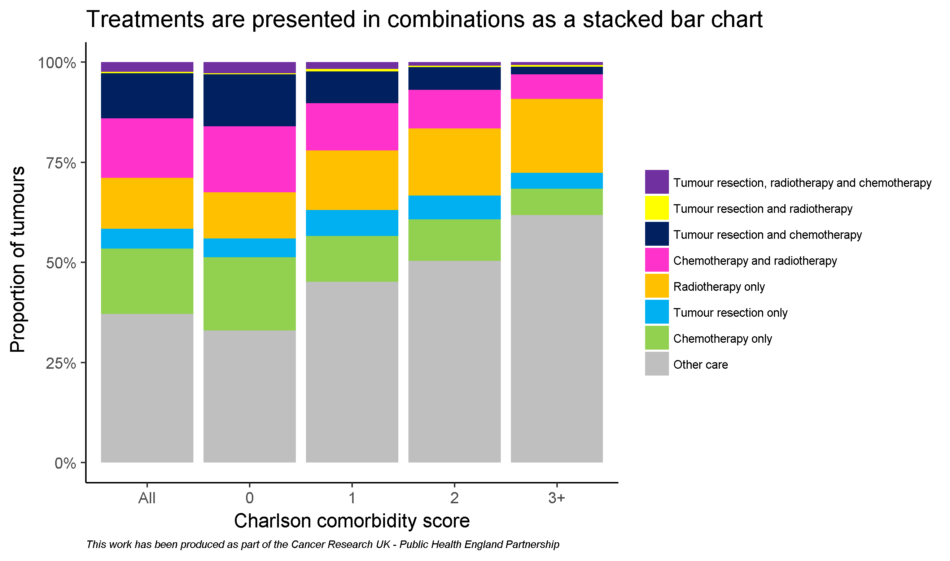
By comorbidity score

Slide 27
Acknowledgements
Public Health England and Cancer Research UK would like to thank the following analysts who developed this workbook:
Dr. Sean McPhail, Dr. Katherine Henson, Anna Fry, Becky White
We would like to thank the following analysts who contributed to the work:
Clare Pearson, Sabrina Sandhu, Carolynn Gildea, Jess Fraser, Michael Wallington, Cong Chen
We would also like to thank the following clinicians and analysts who offered feedback on this workbook or helped improve the tumour resections data featured in it:
Dr. Andy Nordin, Mr. Kieran Horgan, Mr. Ravinder Vohra,
Prof. Mick Peake, Prof. Eva Morris, Mr. Keith Roberts,
Mr. Graham Putnam, Dr. Roland Valori, Prof. Hemant Kocher,
Mr. Roger Kockelbergh, Prof. Paul Finan

