Slide 1
Treatment breakdown for ovary cancers
This work has been produced as part of the Cancer Research UK - Public Health England Partnership. Contributors are listed at the end.

Slide 2
Methods 1)
These slides present the numbers and percentages of tumours diagnosed in England in 2013 - 2015 recorded as receiving radiotherapy, chemotherapy or tumour resection. The results are presented by year, stage at diagnosis, age, sex, deprivation, ethnicity, and comorbidities. The stage distribution is presented, followed by the treatment breakdown (independently and in combinations) for each variable.
This work uses data collected by the NHS, as part of the care and support of cancer patients.
Detail on methodology is described in the SOP and workbook (here) and summarised below:
These proportions are unadjusted, so patterns may be caused by differences in stage, deprivation, age, sex, ethnicity, comorbidities or other factors, such as patient choice.
Datasets used to capture treatment information include cancer registration data, the Systemic Anti-Cancer Therapy dataset (SACT), RadioTherapy DataSet (RTDS), and inpatient Hospital Episode Statistics (HES).
A tumour resection is an attempt to surgically remove the whole of the primary tumour.
Radiotherapy includes both curative and palliative teletherapy procedures, and excludes brachytherapy and contact radiotherapy.
Chemotherapy includes both curative and palliative chemotherapy, and excludes hormonal therapy, and other supportive drugs such as zoledronic acid, pamidronate, and denosumab.

Slide 3
Methods 2)
On the graphs which display combinations of treatments received, one of the categories is ‘Other care’. ‘Other care’ represents the group of patients who had no record of chemotherapy, tumour resection, or radiotherapy in the time frame assessed. This may include patients who received other treatments (such as hormonal therapy or management of symptoms), treatment outside of the time frame assessed, treatment in a private setting, or there may be data missing from the datasets used.
The patient's Charlson comorbidity score was derived from Hospital Episodes Statistics (HES) and Cancer Registry data combined, and looks from 27 months to 3 months before the patient's cancer diagnosis.
The patient’s age group was based on the age of the patient when they were diagnosed with the tumour.
The patient’s income deprivation quintile was allocated by linking the patient’s postcode to their 2011 ONS census lower super output area (LSOA). This was then linked to the Ministry of Housing, Communities & Local Government 2015 income deprivation quintile for that LSOA.
Treatments occurring in the period from 1 month before diagnosis to either 6, 9, 12, 15 or 18 months after diagnosis are displayed. The time period within which most patients' first course of treatment occurred varies by cancer site and treatment type. Therefore, an appropriate time period for each cancer site has been chosen using a data-driven approach in consultation with clinicians (see SOP for more information).

Slide 4
Summary of key results
The display of treatments as combinations is more informative than where the treatments are displayed independently, as this reflects clinical practice and indicates cohorts who likely do not receive anti-cancer treatment (the majority of “other care” for ovarian tumours)
Stage: The pattern intuitively reflects clinical reality – most stage 1 tumours are treated with resection only, and for stages above that, the standard treatment is resection with chemotherapy (or just chemotherapy for stage 4).
Age: A worryingly high percentage (60%) of 80+ year olds is in the ‘other care’ category, likely reflecting no treatment for ovarian tumours. This probably reflects the very high 1 year mortality for this group.
Deprivation: It is encouraging to see that deprivation status does not impact on tumour resection rates. However, there is a drop in chemotherapy in most deprived groups. This could be related to a higher proportion of more deprived patients presenting at later stage, through emergency presentation routes, with poor performance status, or dying before receiving treatment, as results are unadjusted for these factors.
Ethnicity: There are higher resections among non-White patients compared to White. The reason is not clear – it could be socio-economic or biological. For example, non-White individuals may present with ovarian cancer via different routes to diagnosis compared to White patients.
Co-morbidity: The results demonstrate the difficulty of providing effective treatment for patients with complex co-morbidities (55% of those with Charlson comorbidity score 3+ receive ‘other care’).

Slide 5
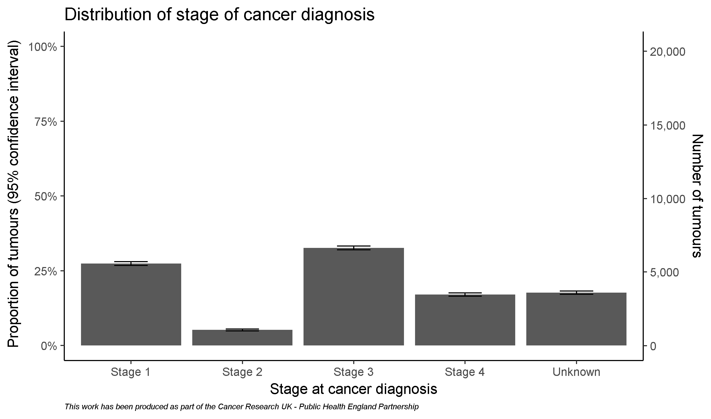
Cohort for ovary cancers

Slide 6
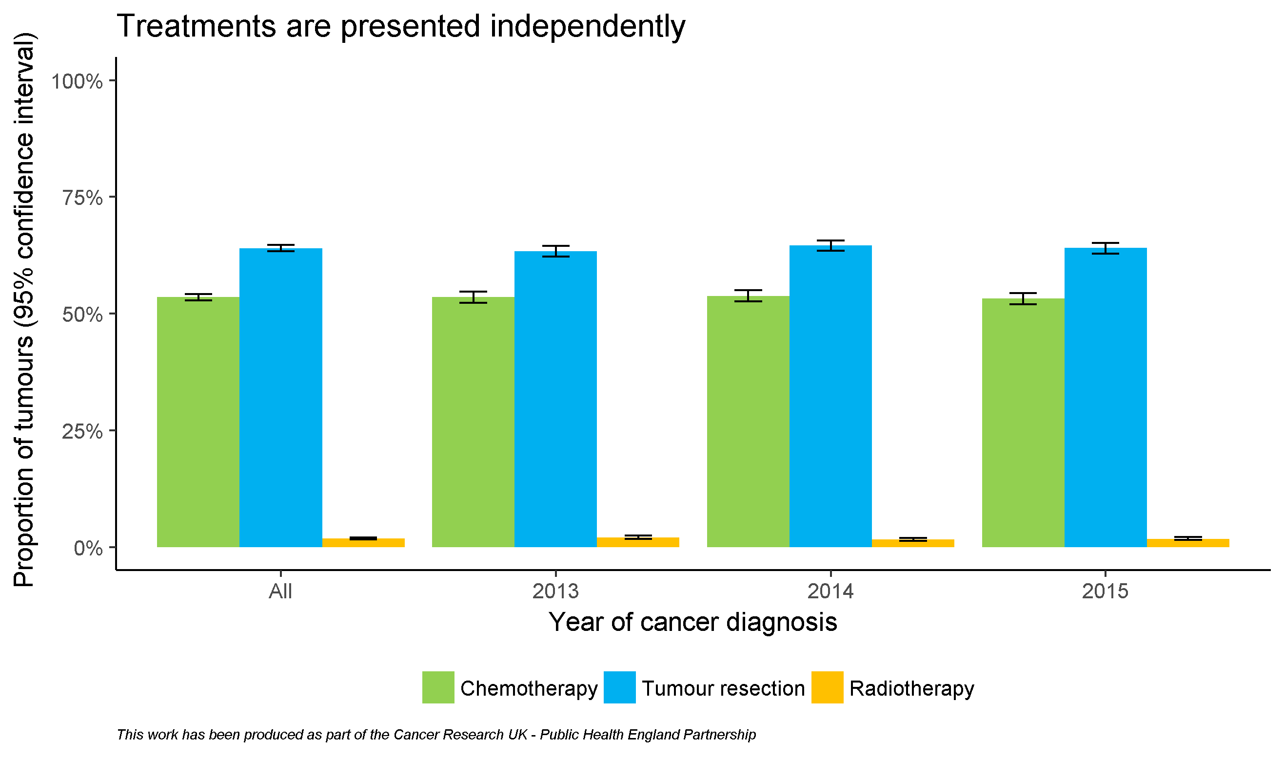
By diagnosis year

Slide 7
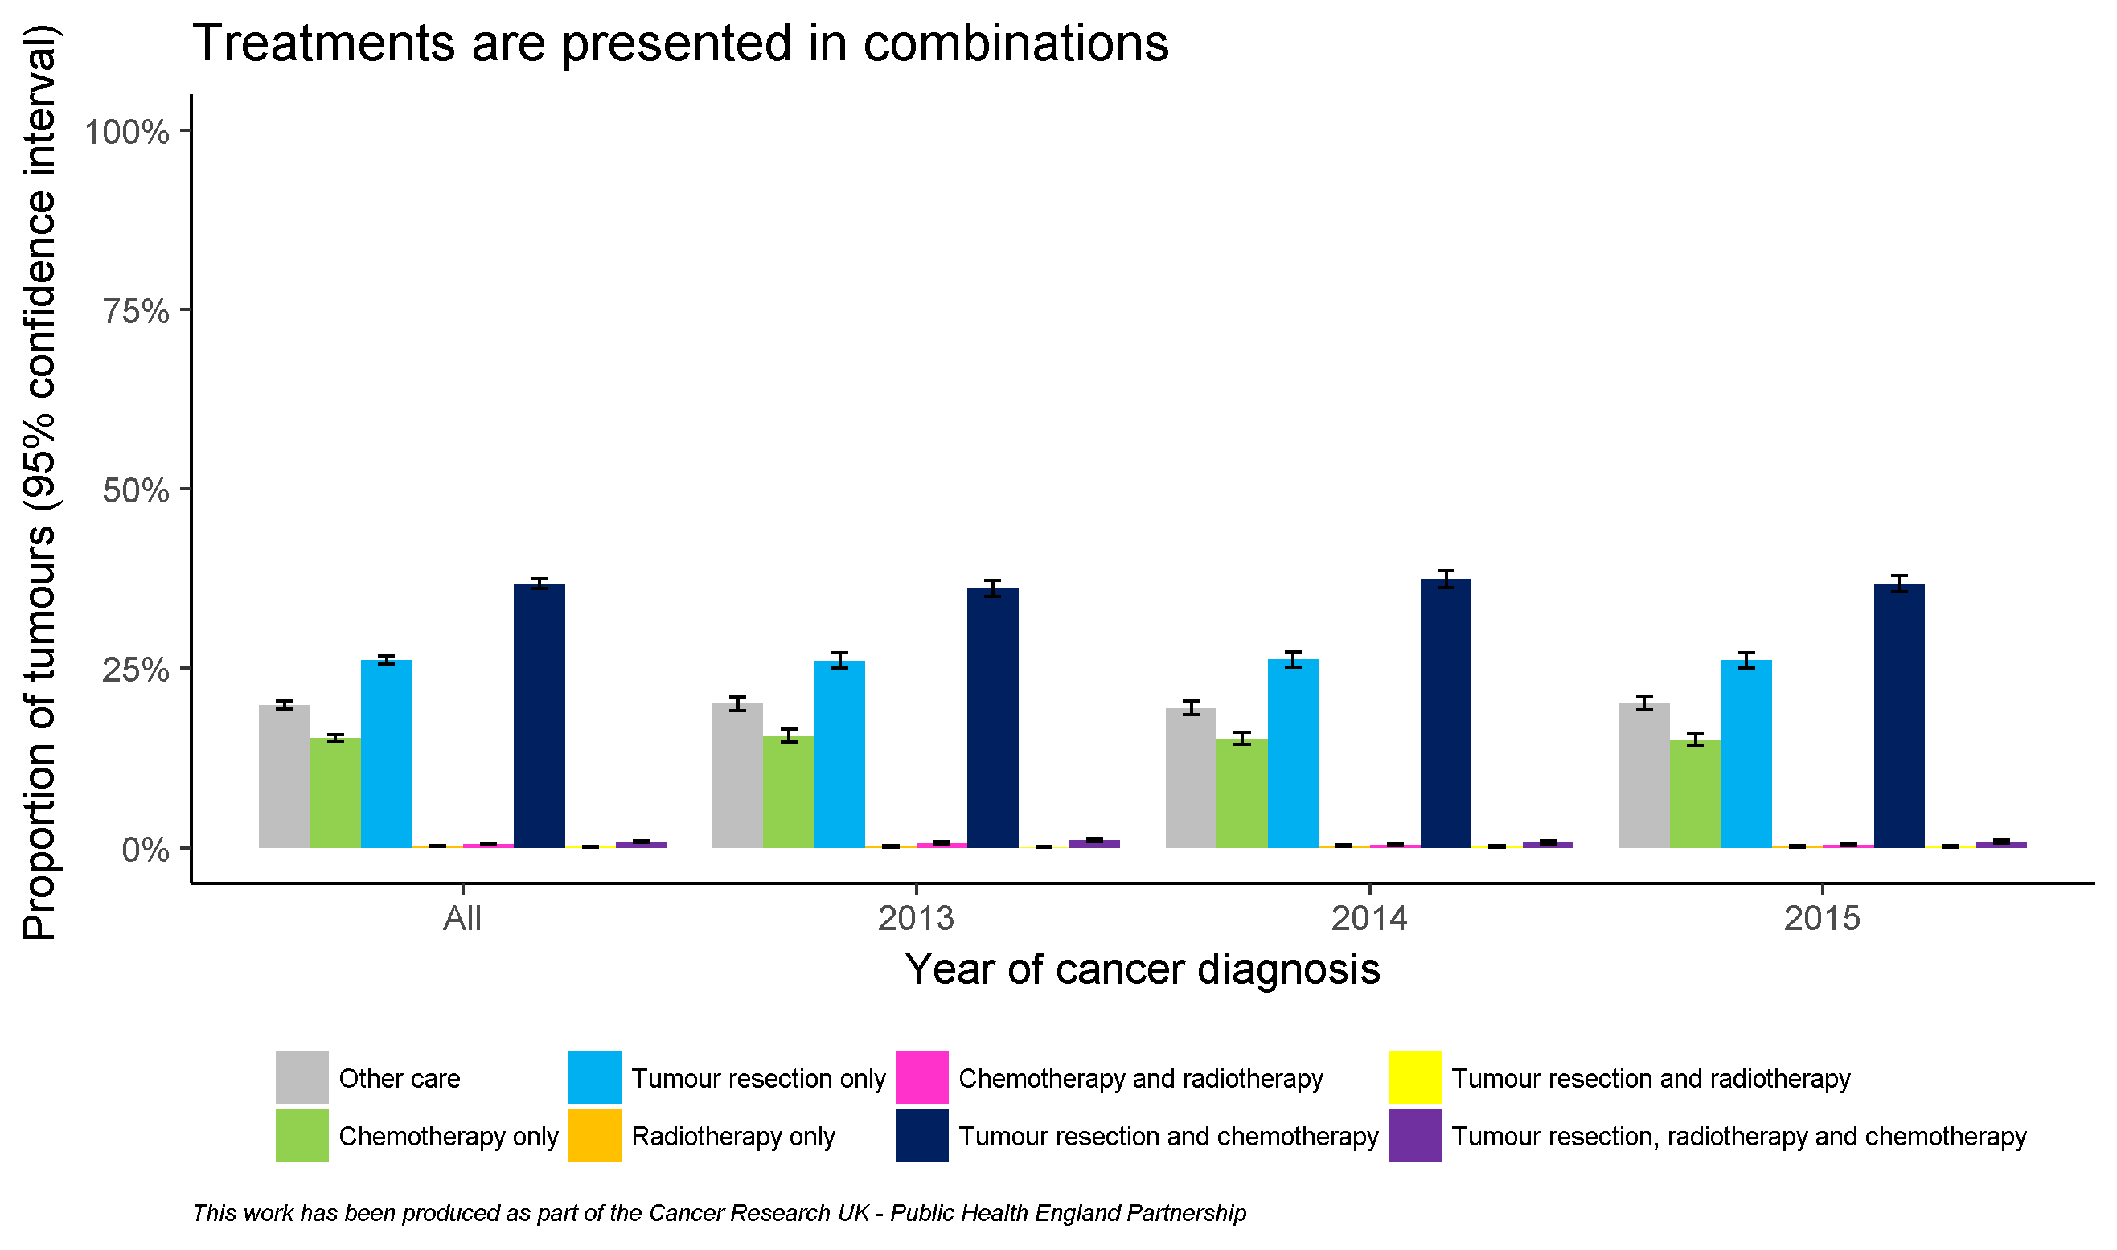
By diagnosis year

Slide 8
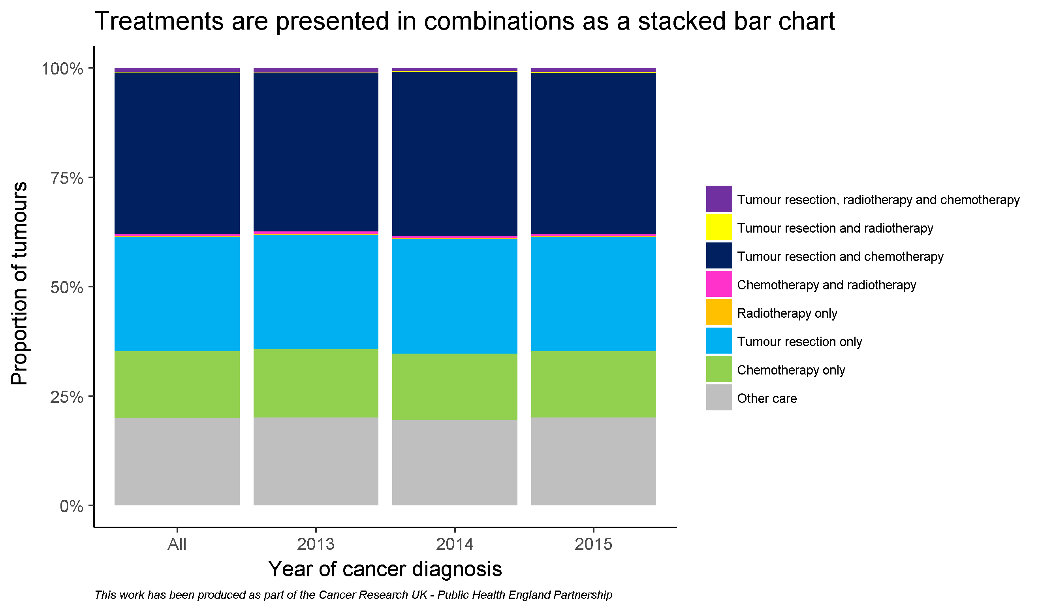
By diagnosis year

Slide 9
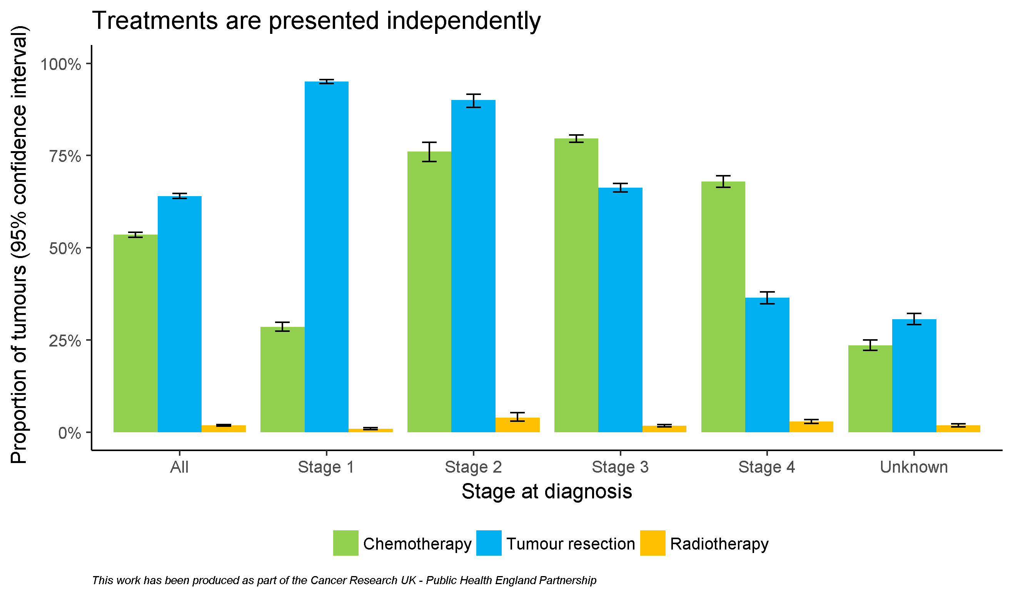
By stage

Slide 10
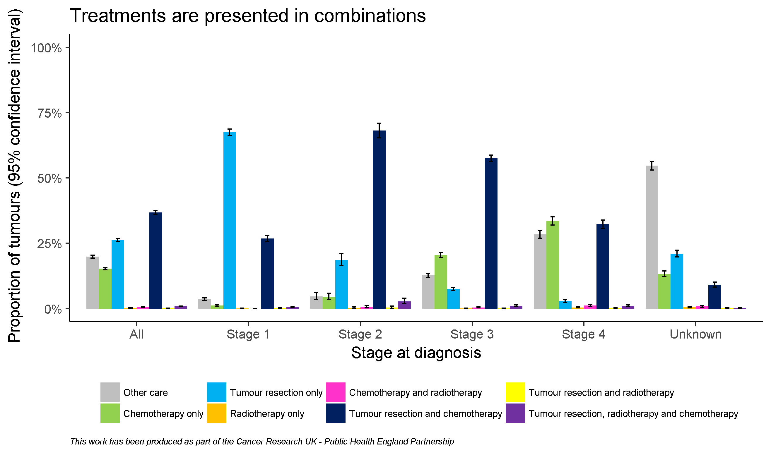
By stage

Slide 11
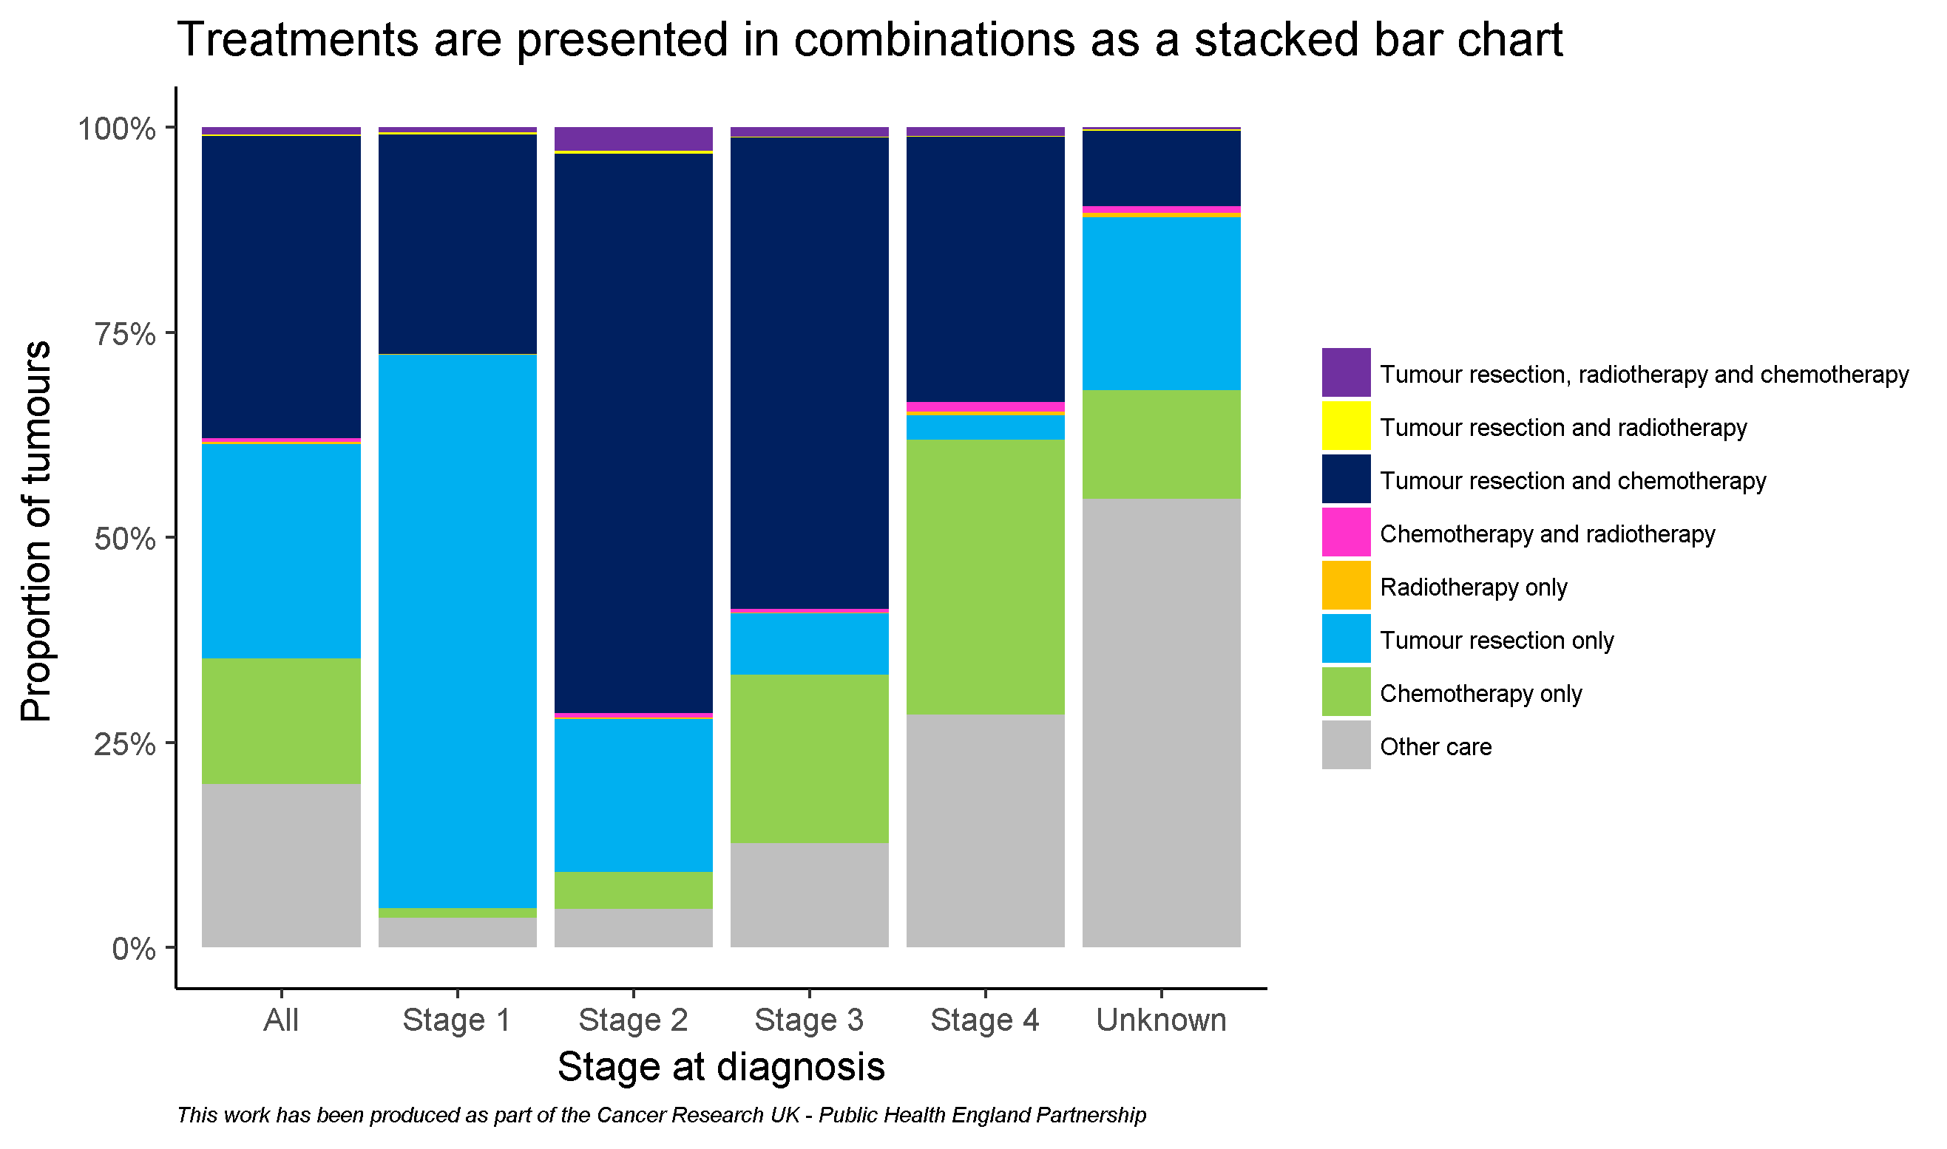
By stage

Slide 12
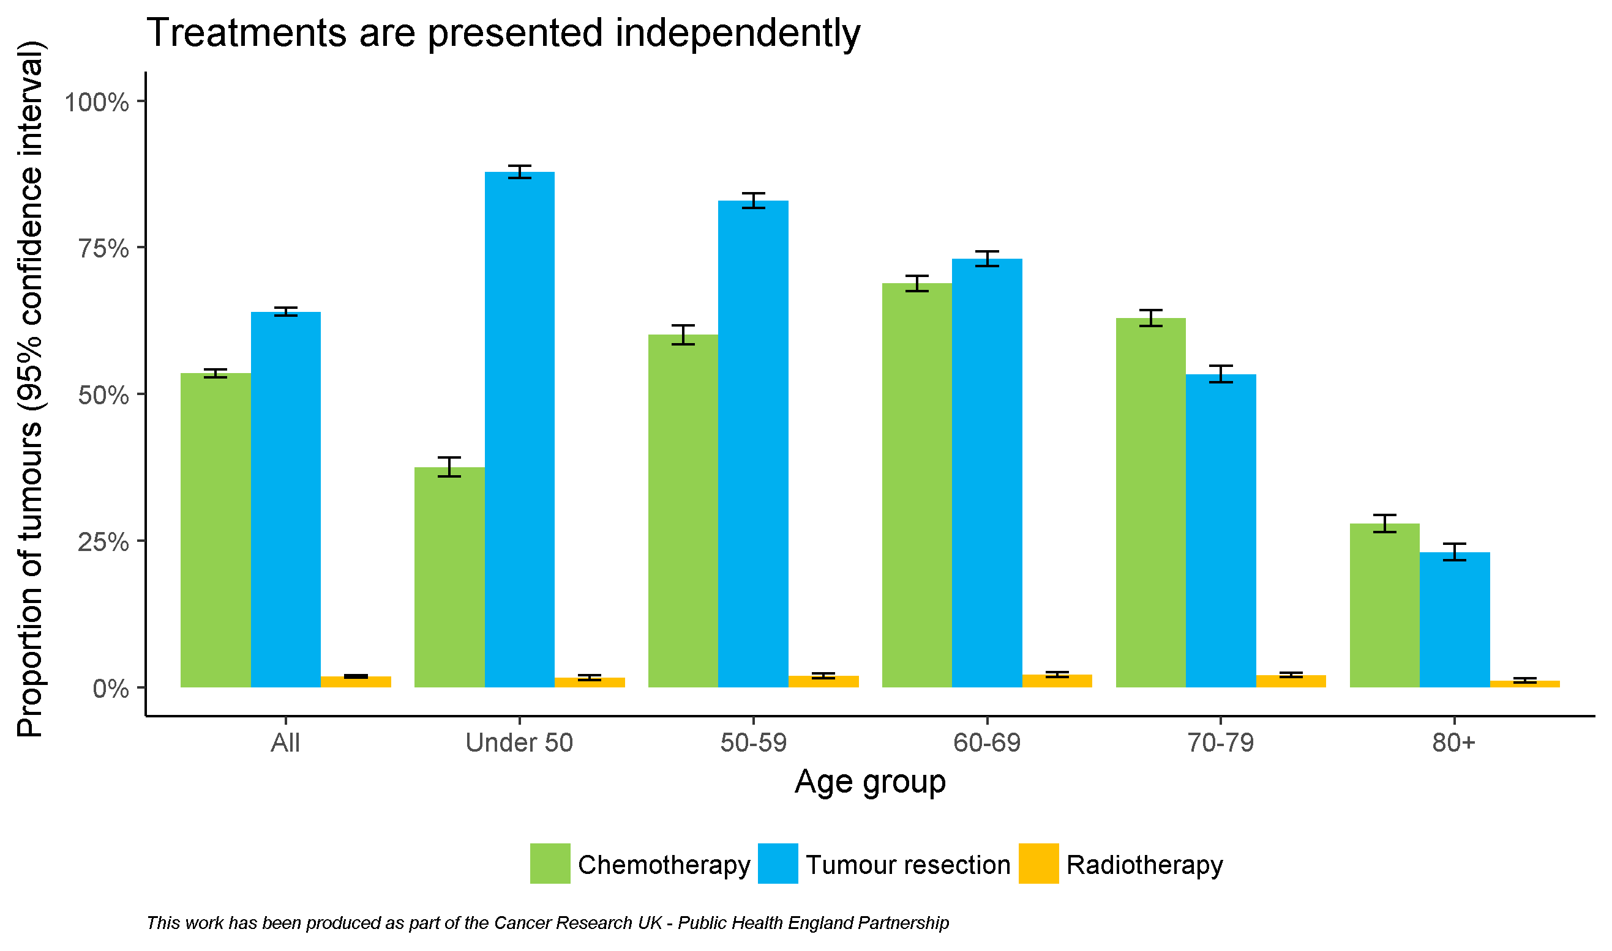
By age

Slide 13
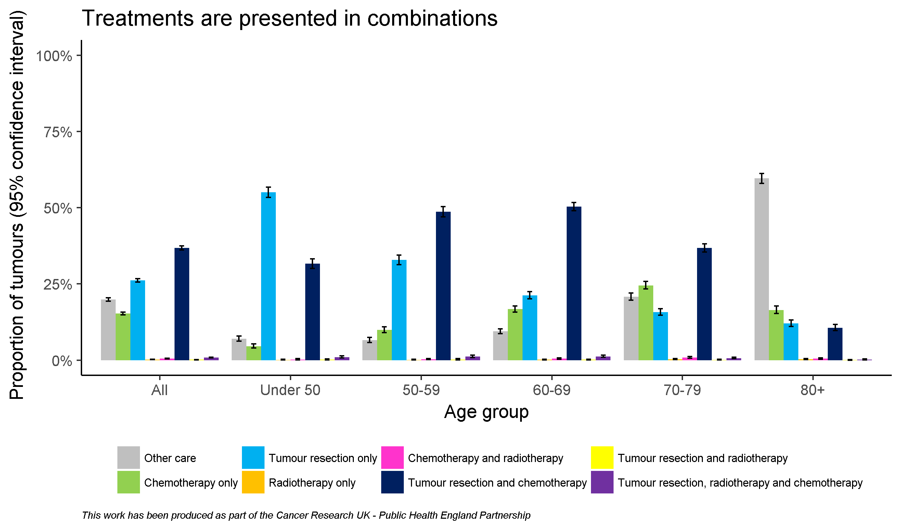
By age

Slide 14
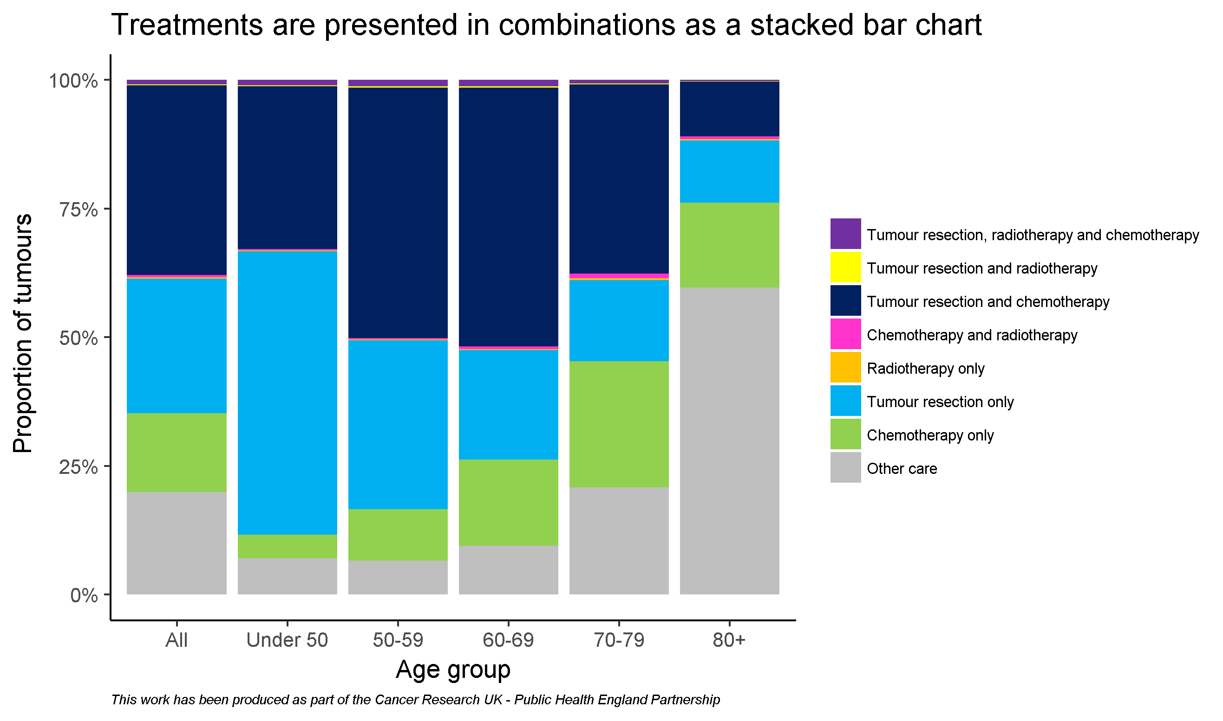
By age

Slide 15
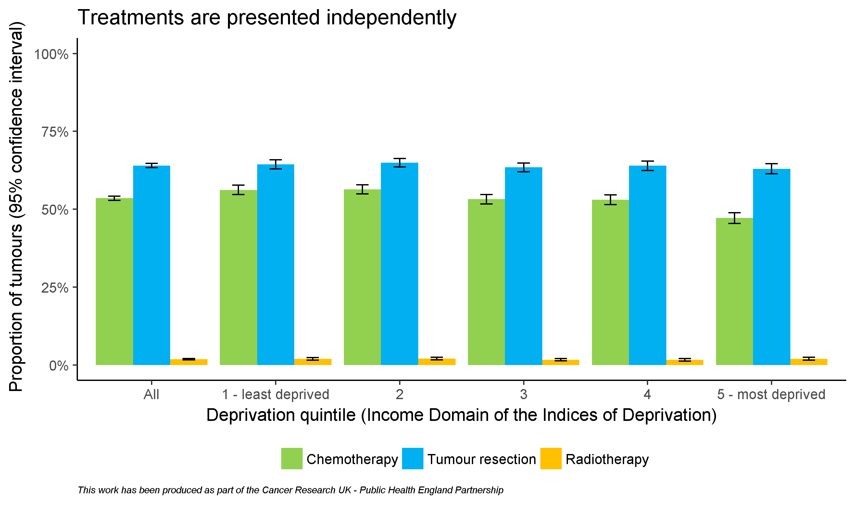
By deprivation quintile

Slide 16
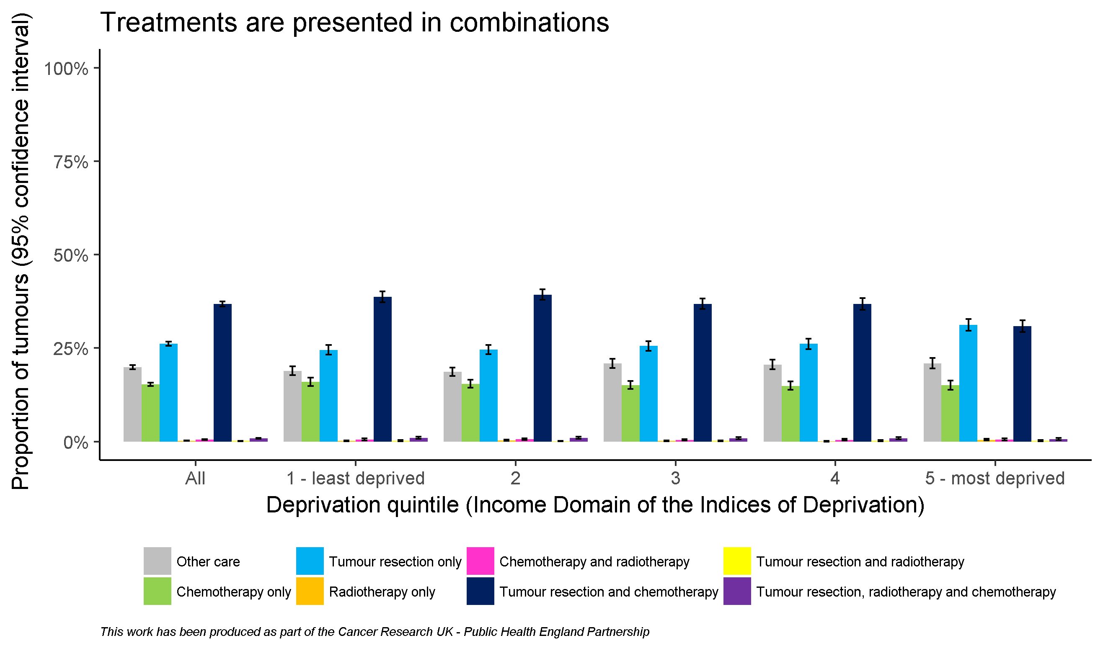
By deprivation quintile

Slide 17
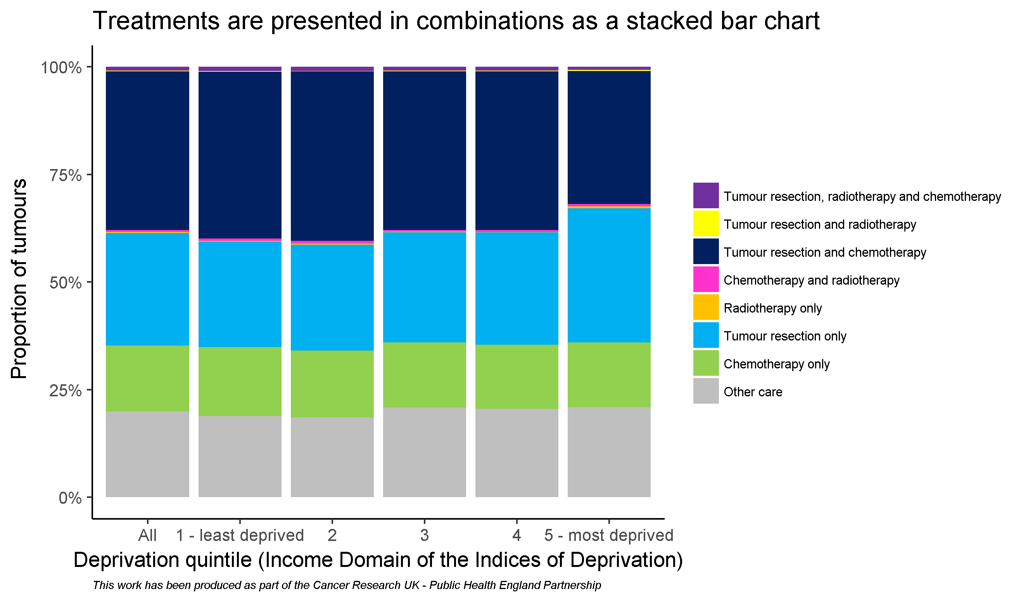
By deprivation quintile

Slide 18
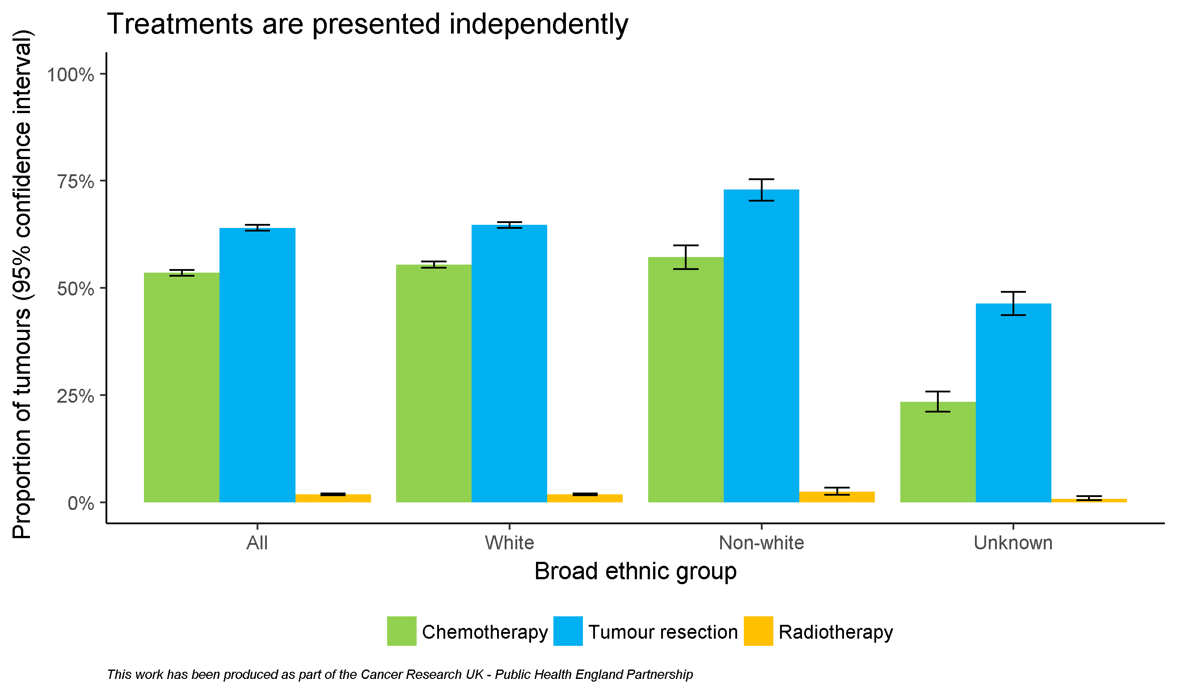
By broad ethnic group

Slide 19
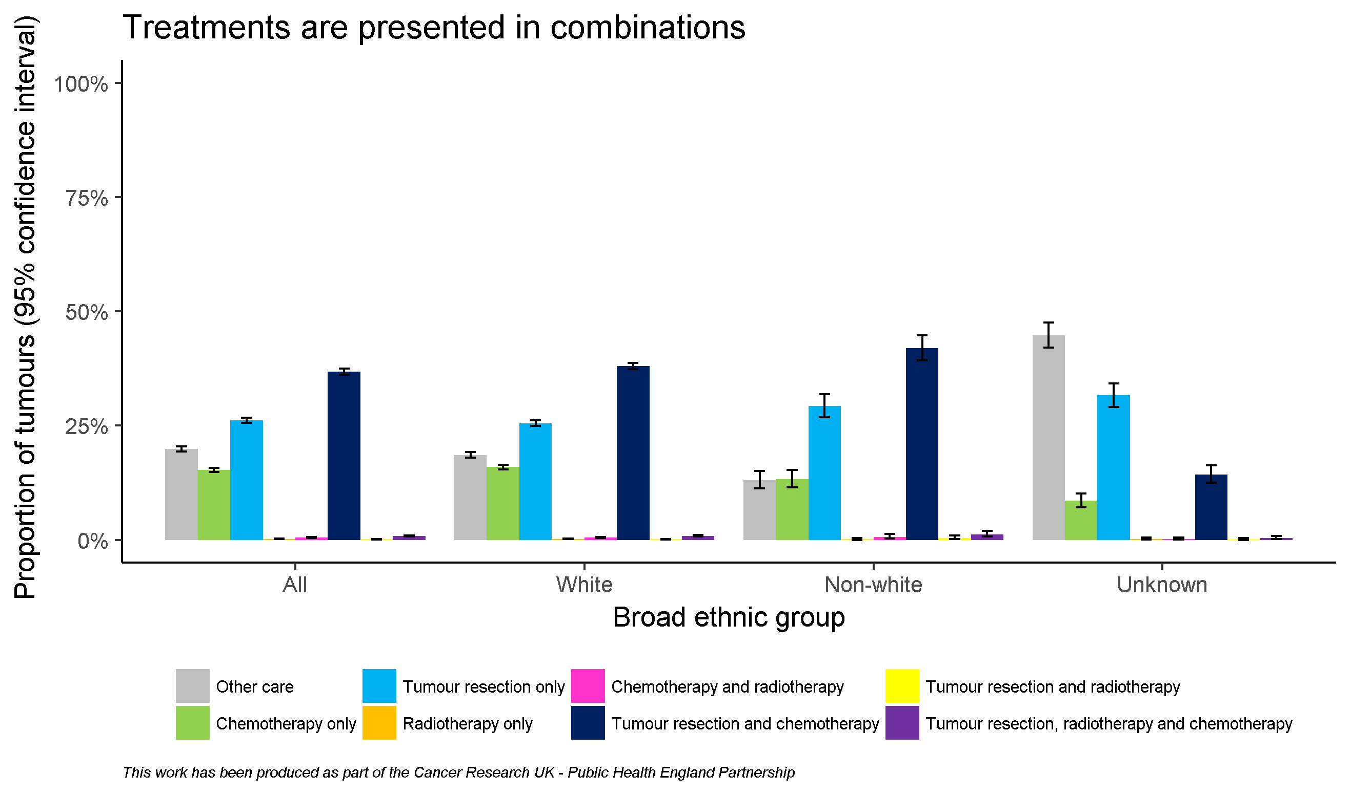
By broad ethnic group

Slide 20
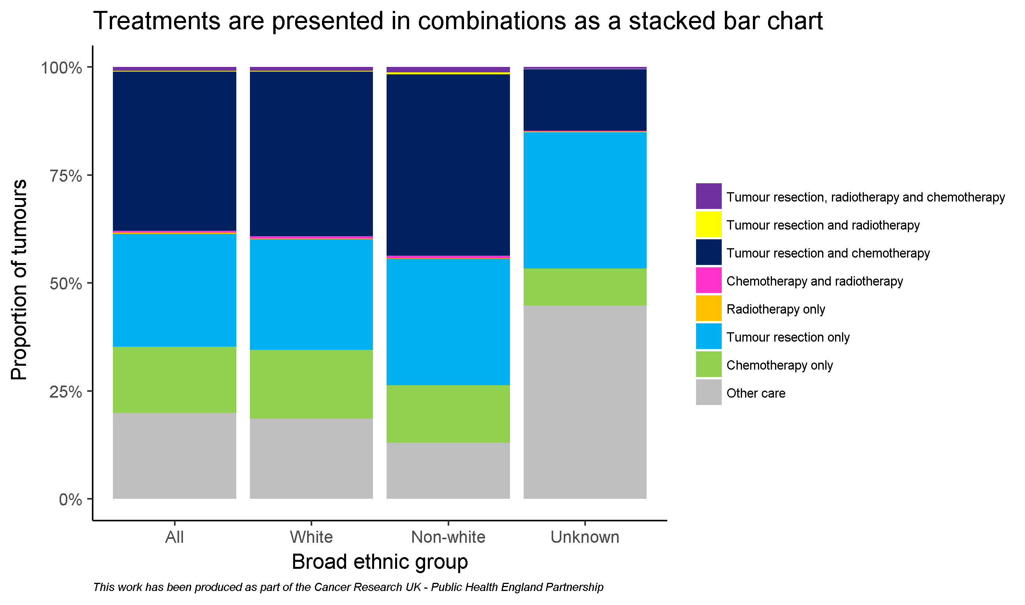
By broad ethnic group

Slide 21
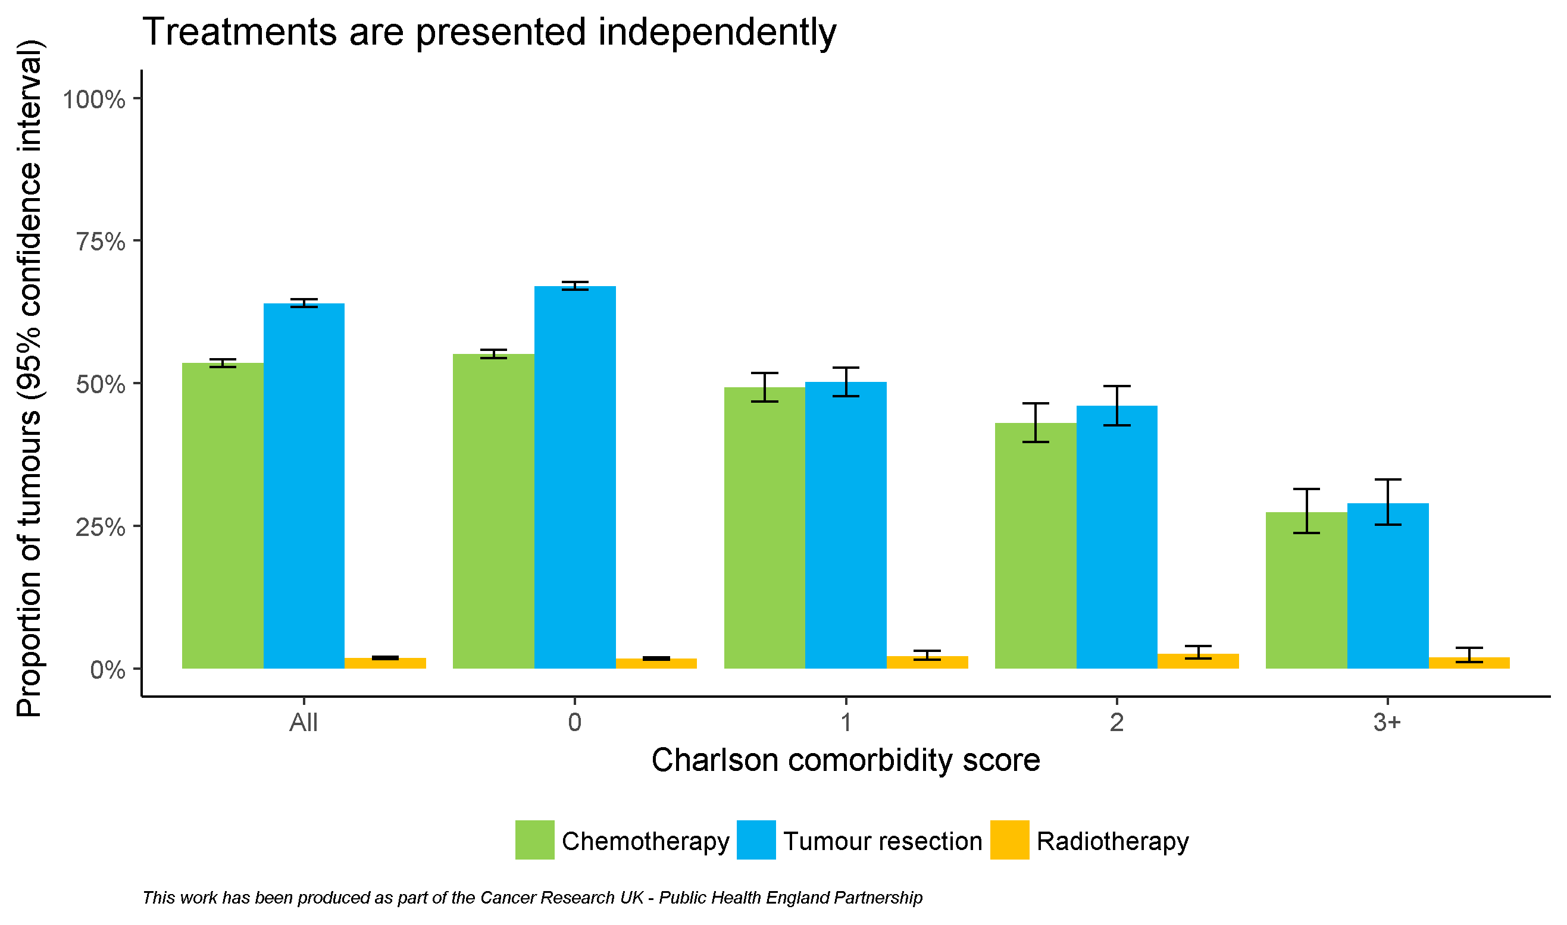
By comorbidity score

Slide 22
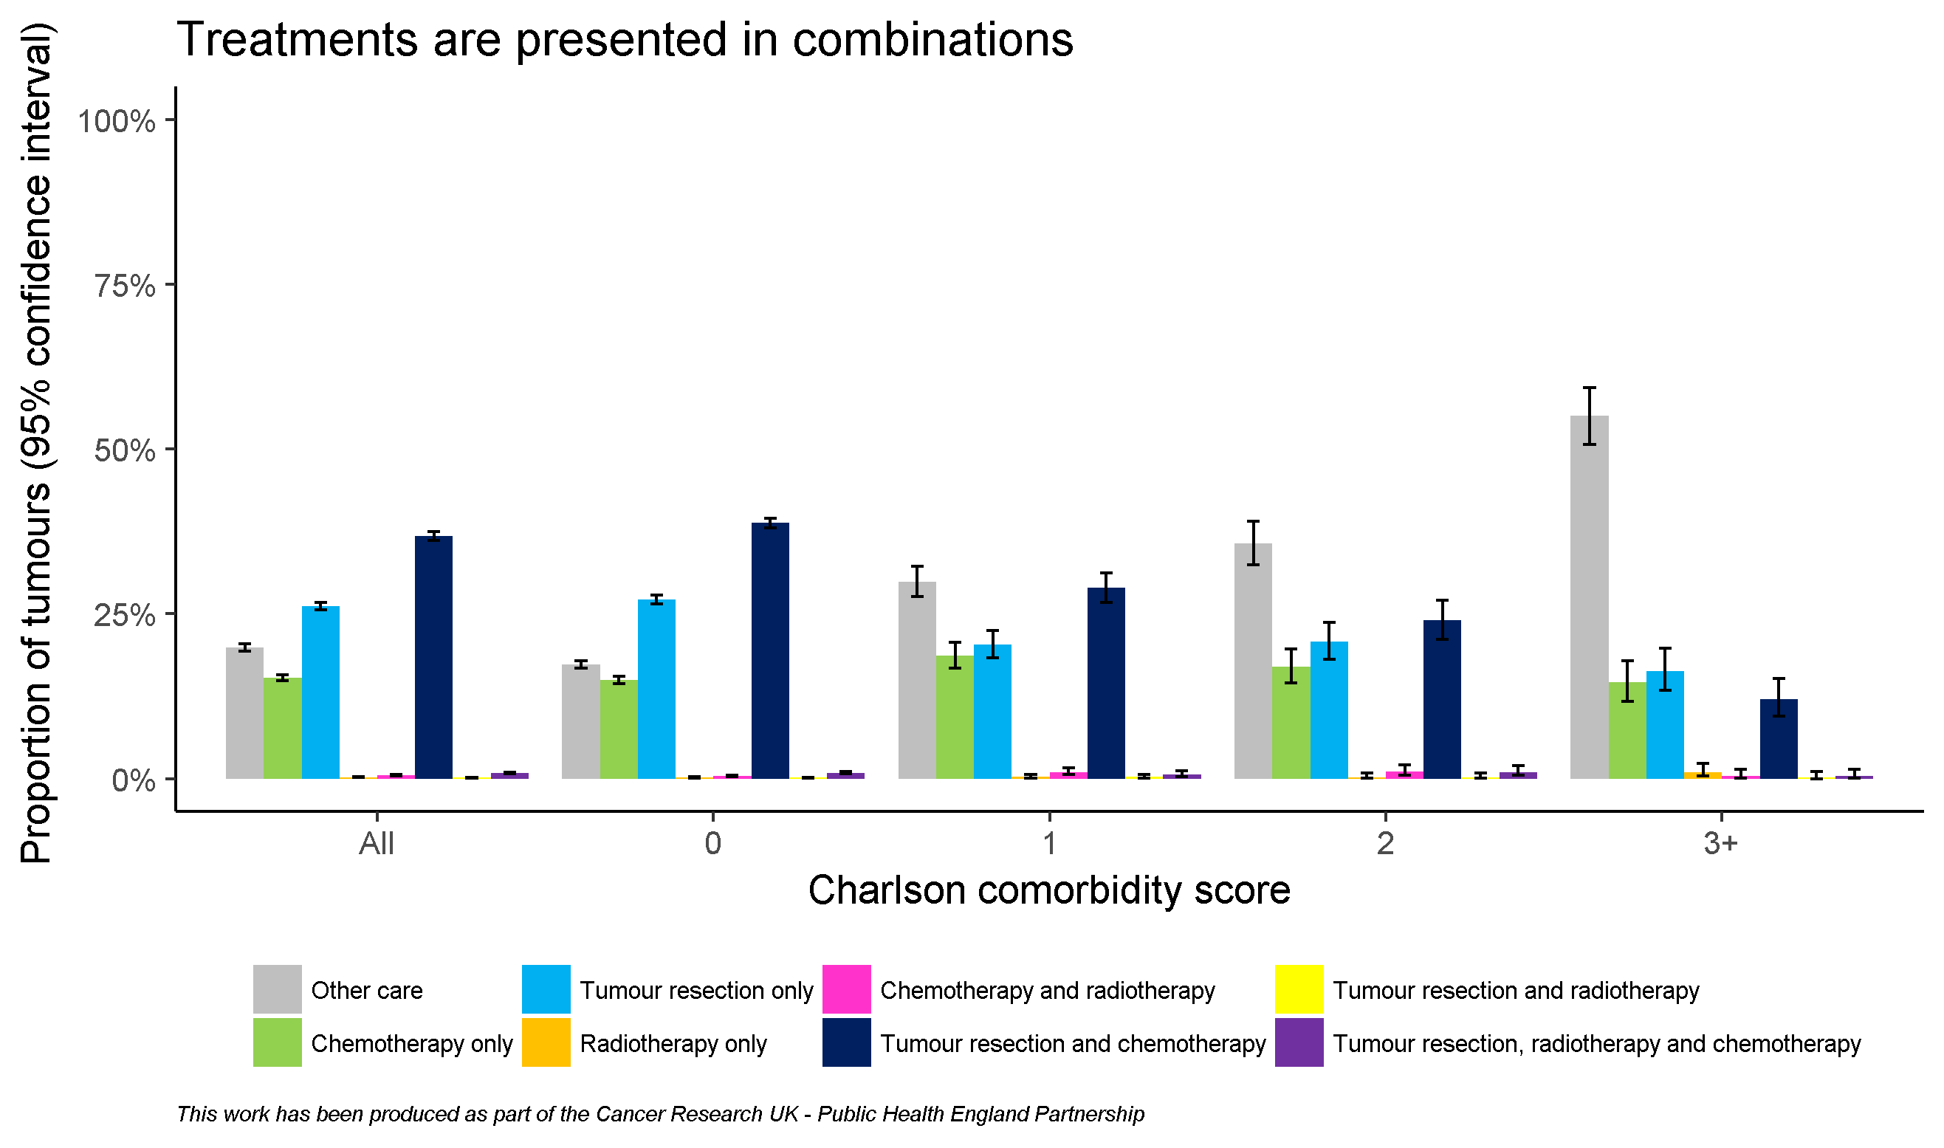
By comorbidity score

Slide 23
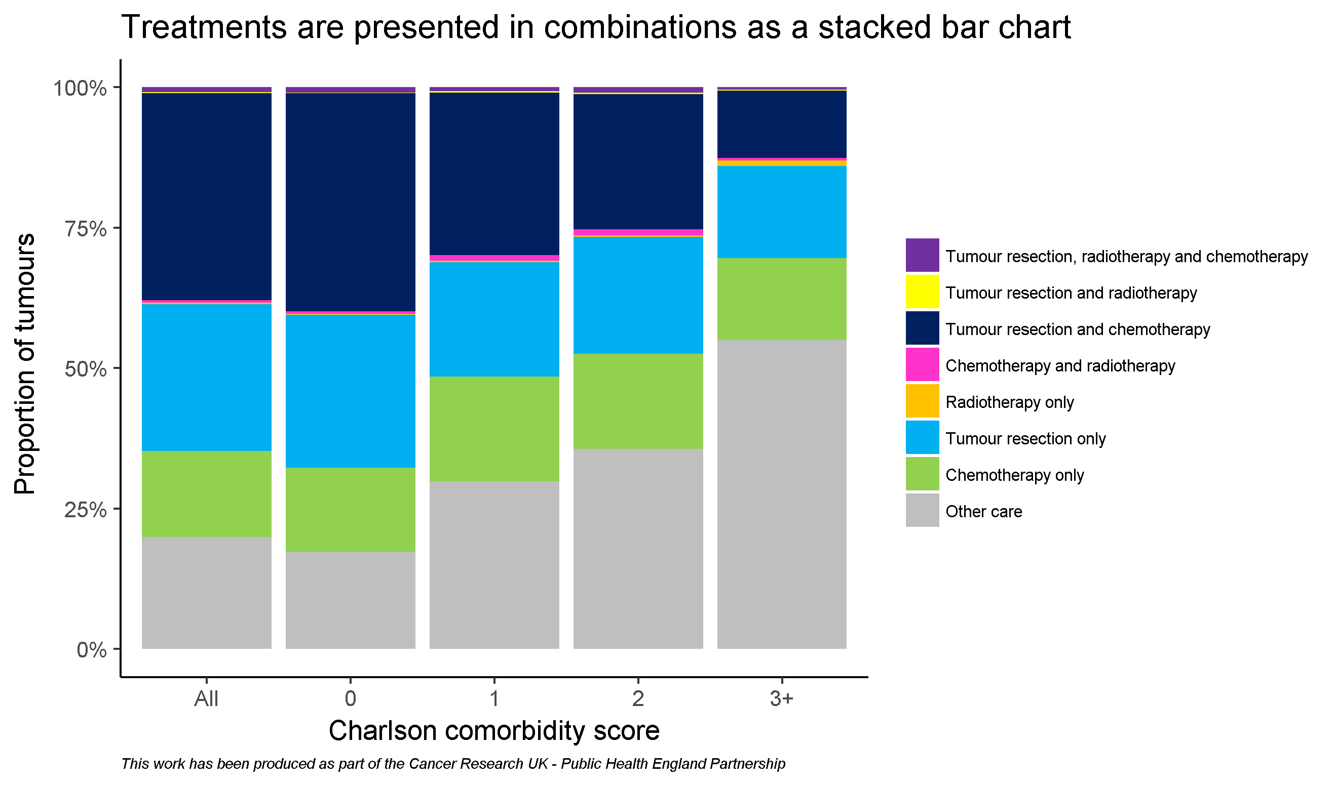
By comorbidity score

Slide 24
Acknowledgements
Public Health England and Cancer Research UK would like to thank the following analysts who developed this workbook:
Dr. Sean McPhail, Dr. Katherine Henson, Anna Fry, Becky White
We would like to thank the following analysts who contributed to the work:
Clare Pearson, Sabrina Sandhu, Carolynn Gildea, Jess Fraser, Michael Wallington, Cong Chen
We would also like to thank the following clinicians and analysts who offered feedback on this workbook or helped improve the tumour resections data featured in it:
Dr. Andy Nordin, Mr. Kieran Horgan, Mr. Ravinder Vohra,
Prof. Mick Peake, Prof. Eva Morris, Mr. Keith Roberts,
Mr. Graham Putnam, Dr. Roland Valori, Prof. Hemant Kocher,
Mr. Roger Kockelbergh, Prof. Paul Finan

